Slide 1
2025 STREET & UTILITY IMPROVEMENTS
Construction Open House – April 17, 2025, at 5:45 pm
Presenter: Cory Bienfang, P.E. – City Engineer

Slide 2
Tonight’s Open House
Project Purpose & Need
Proposed Improvements
Project Phasing
Construction Process
Project Communications During Construction
Overview of Special Assessments
Notes:
Please save questions until the end…

Slide 3
Purpose & Need
Purpose
Continue reconstruction projects consistent with 10-Year Capital Improvement Plan (CIP)
CSAH 37 officially turned back from county road to local city street
Need
Failing pavement surface and lacking storm sewer
Undersized and deteriorated underground utilities – clay sanitary sewer and 4-inch watermain
Pedestrian facility improvements (including adding new sidewalk and protecting previous replaced sidewalk where feasible)

Slide 4
Proposed Improvements
New sanitary sewer and watermain
New storm sewer
New roadway lighting and underground electric
New bituminous roadway pavement
ADA upgrades
New sidewalks along both sides
New ped ramps
New bumpout and RRFB crossing(s)

Slide 5
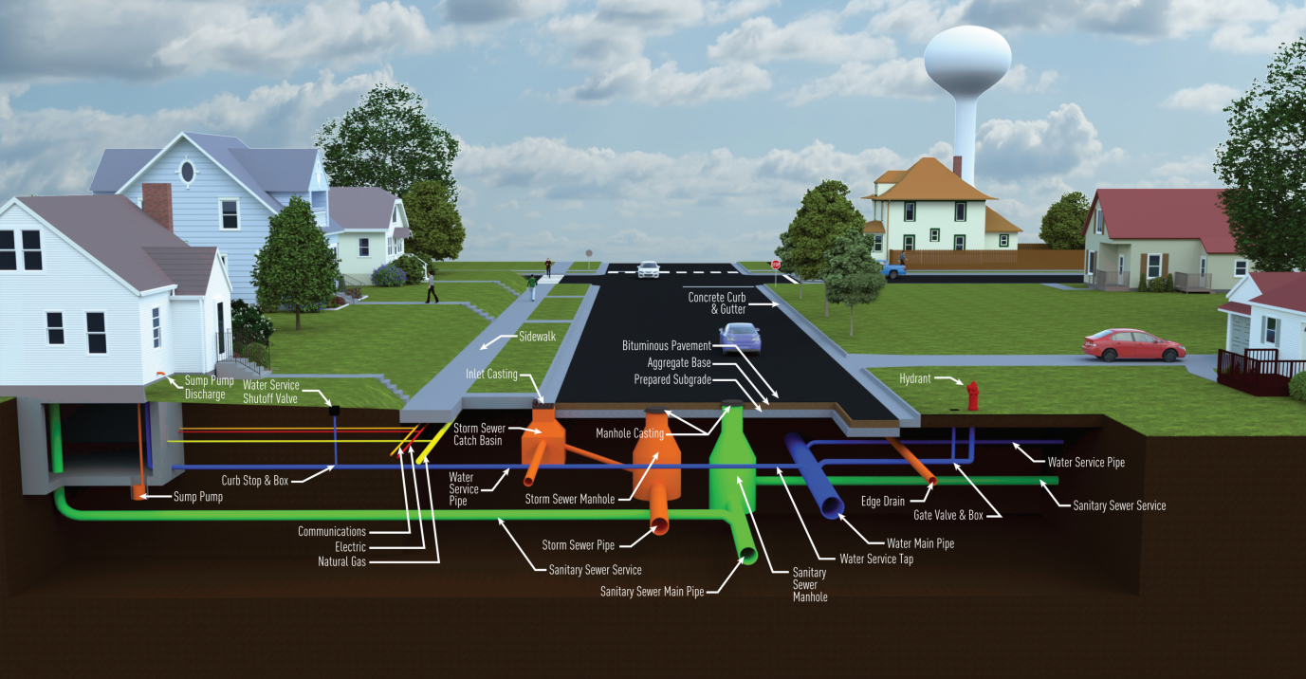
What’s Under My Street

Slide 6
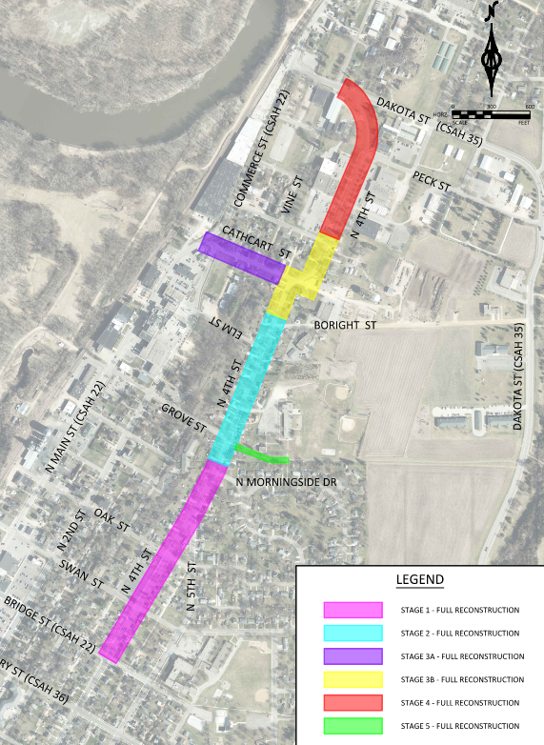
Project Phasing
Majority of construction Spring/Summer/Fall 2025 (April thru November)
All work completed Summer 2026
Final completion Summer 2027
Any major phasing changes will be communicated

Slide 7
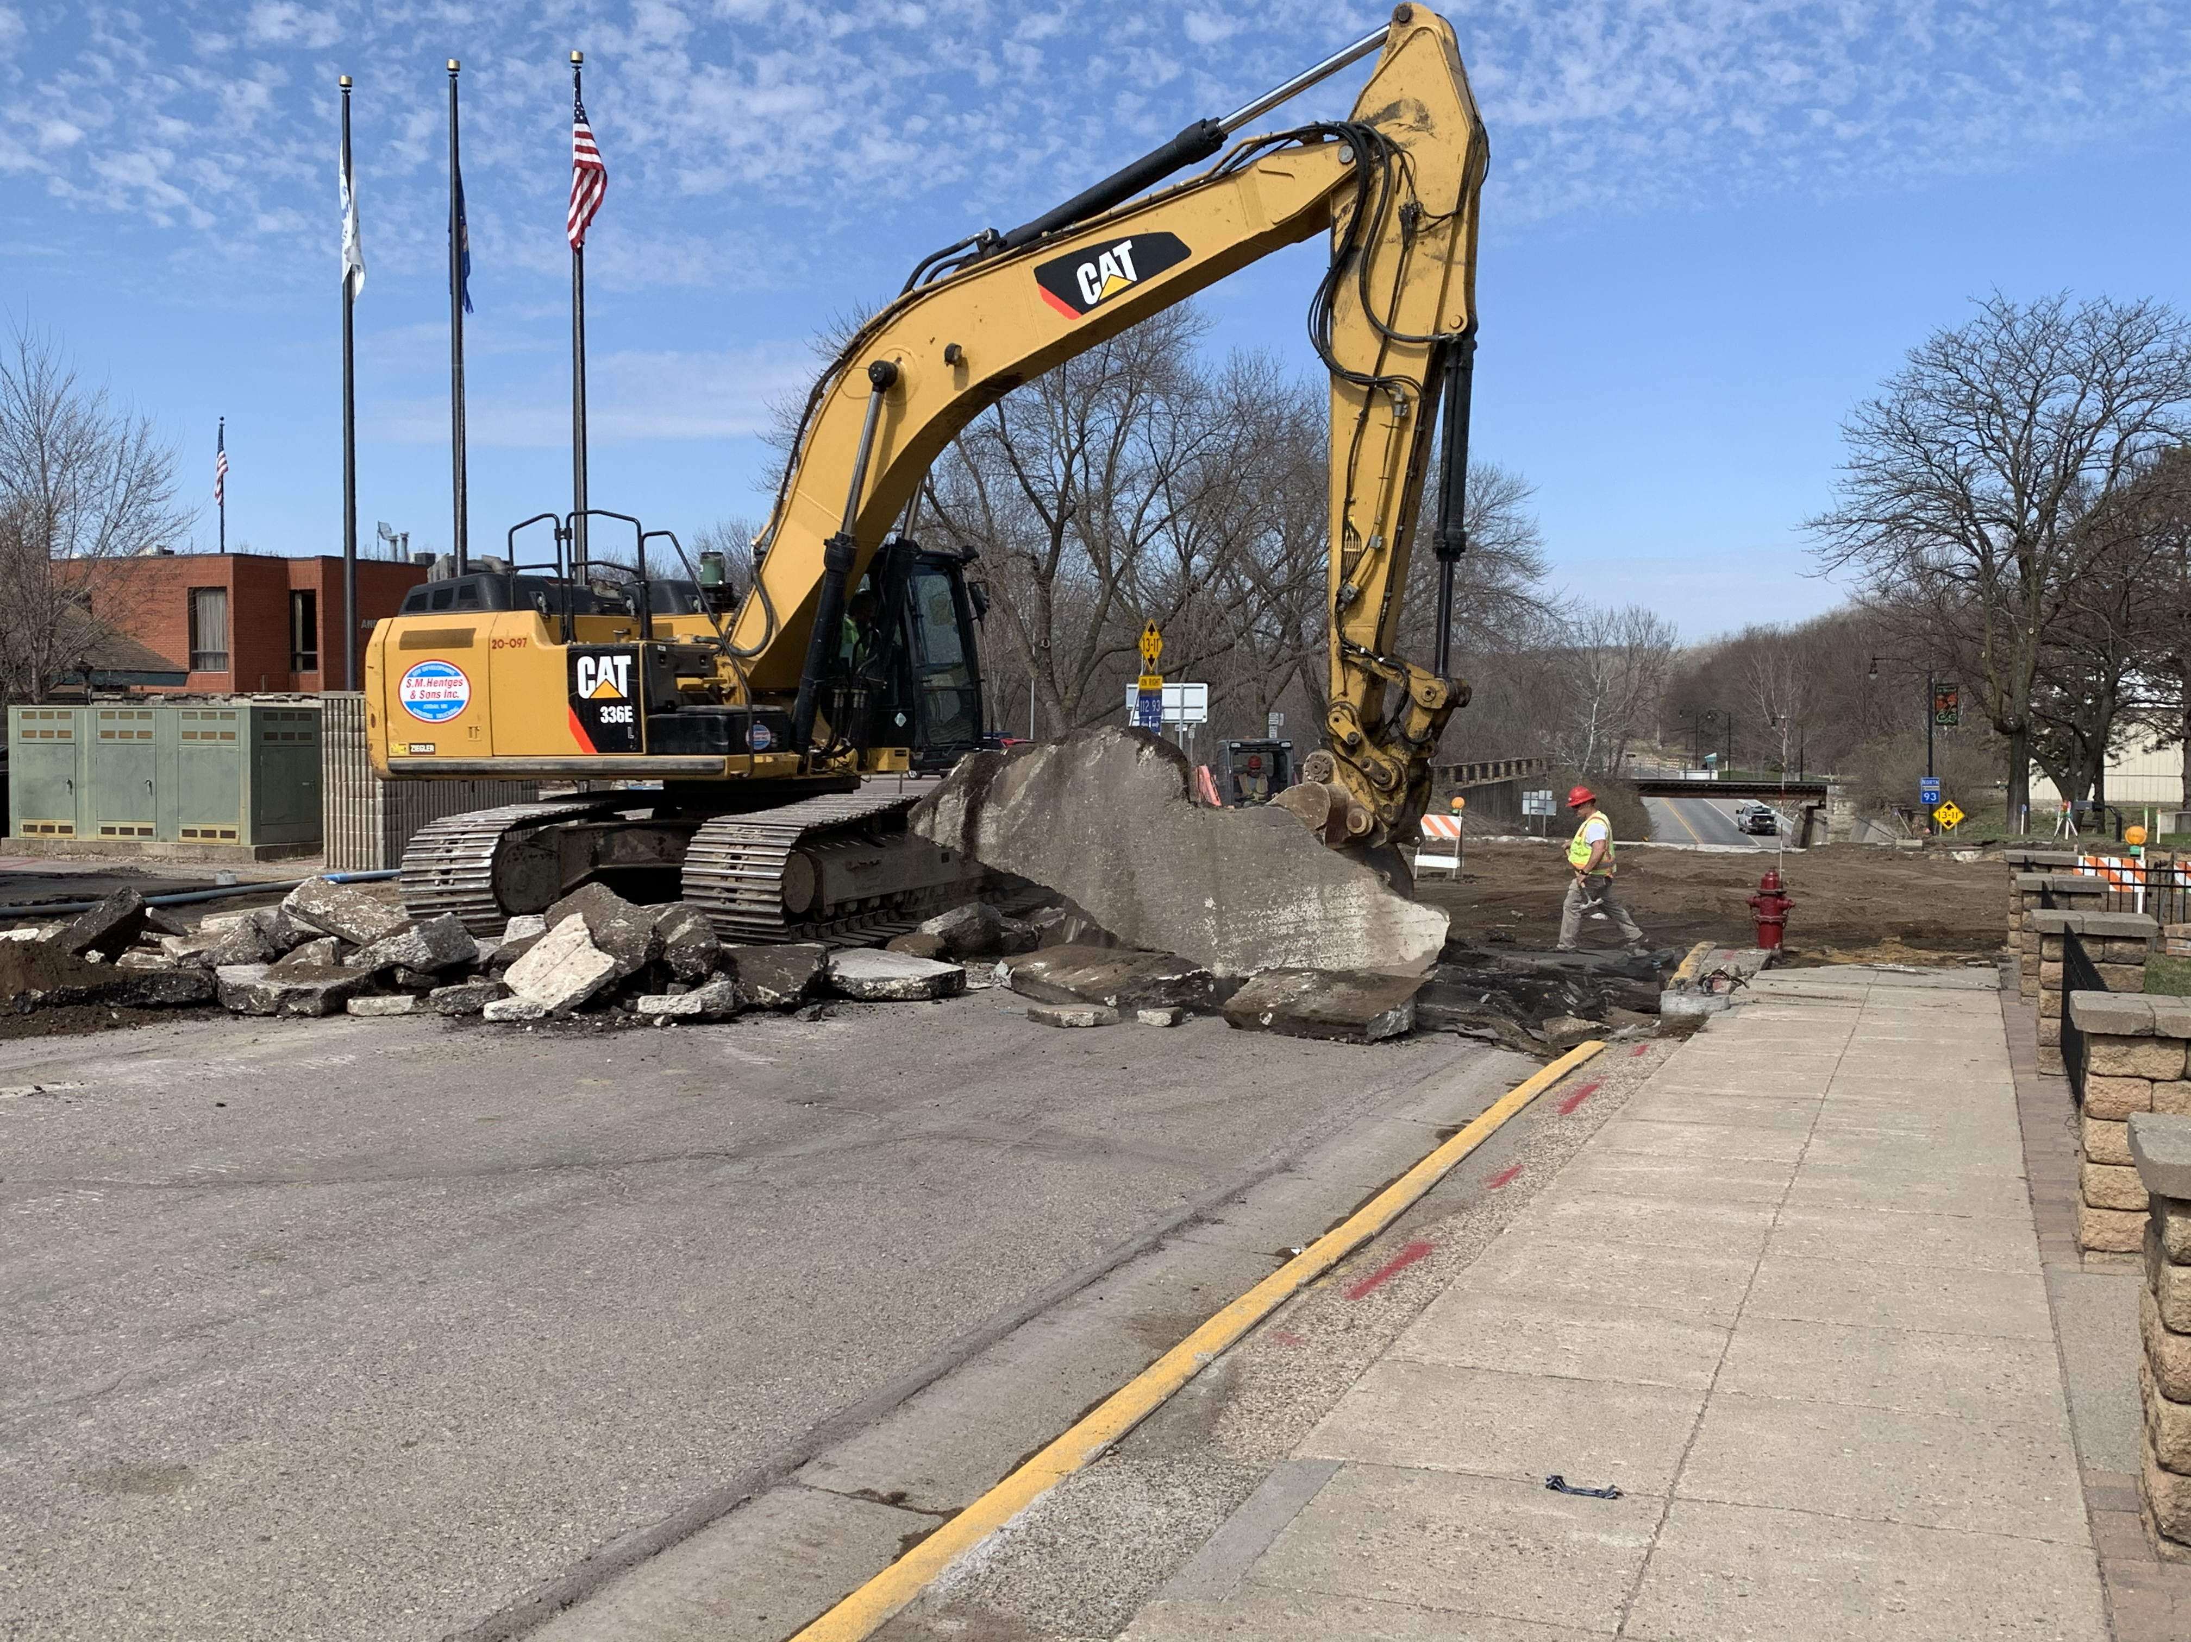
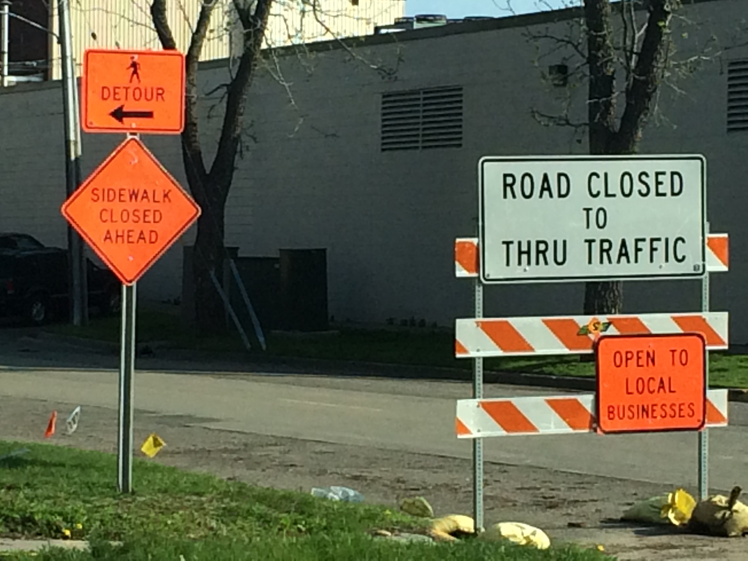
Roadway Closures & Removals

Slide 8
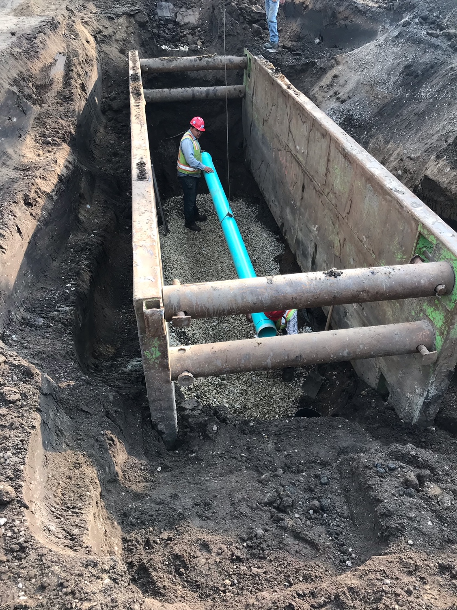
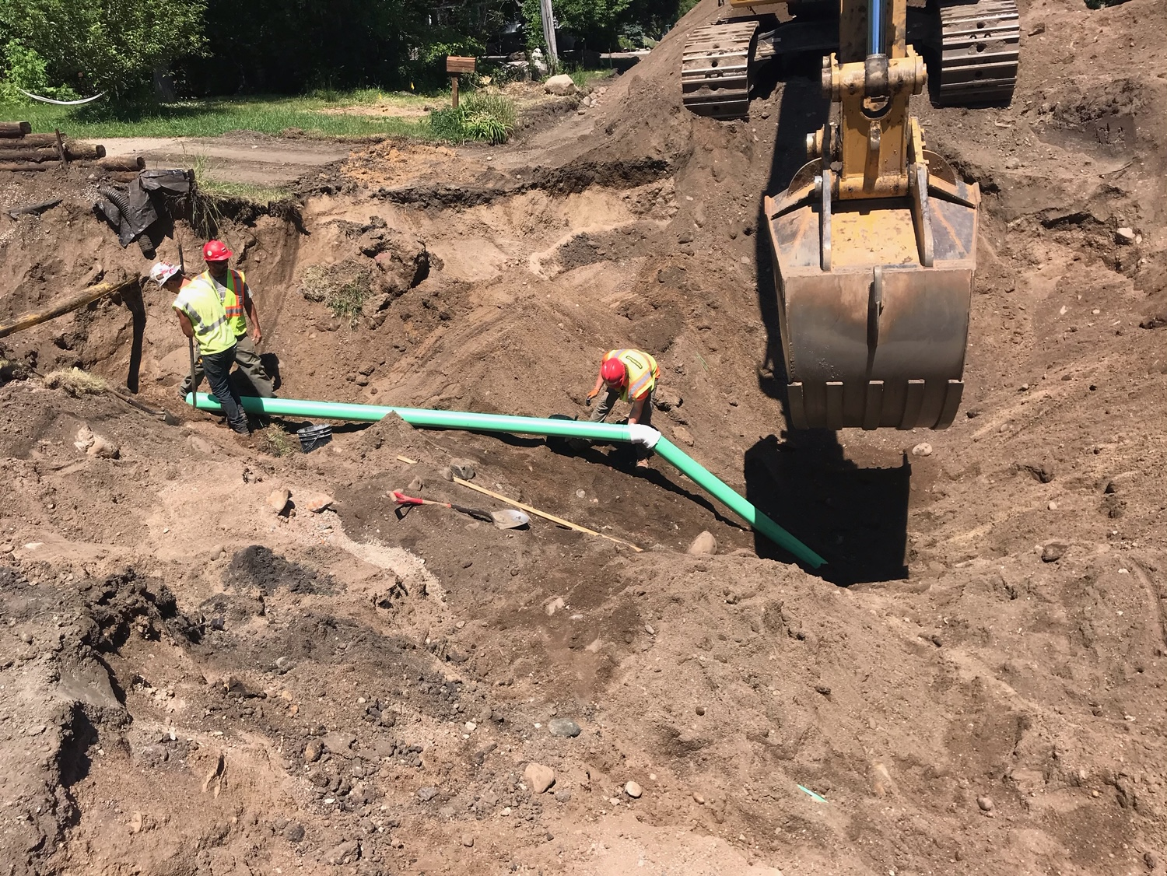
Sanitary Sewer Improvements

Slide 9
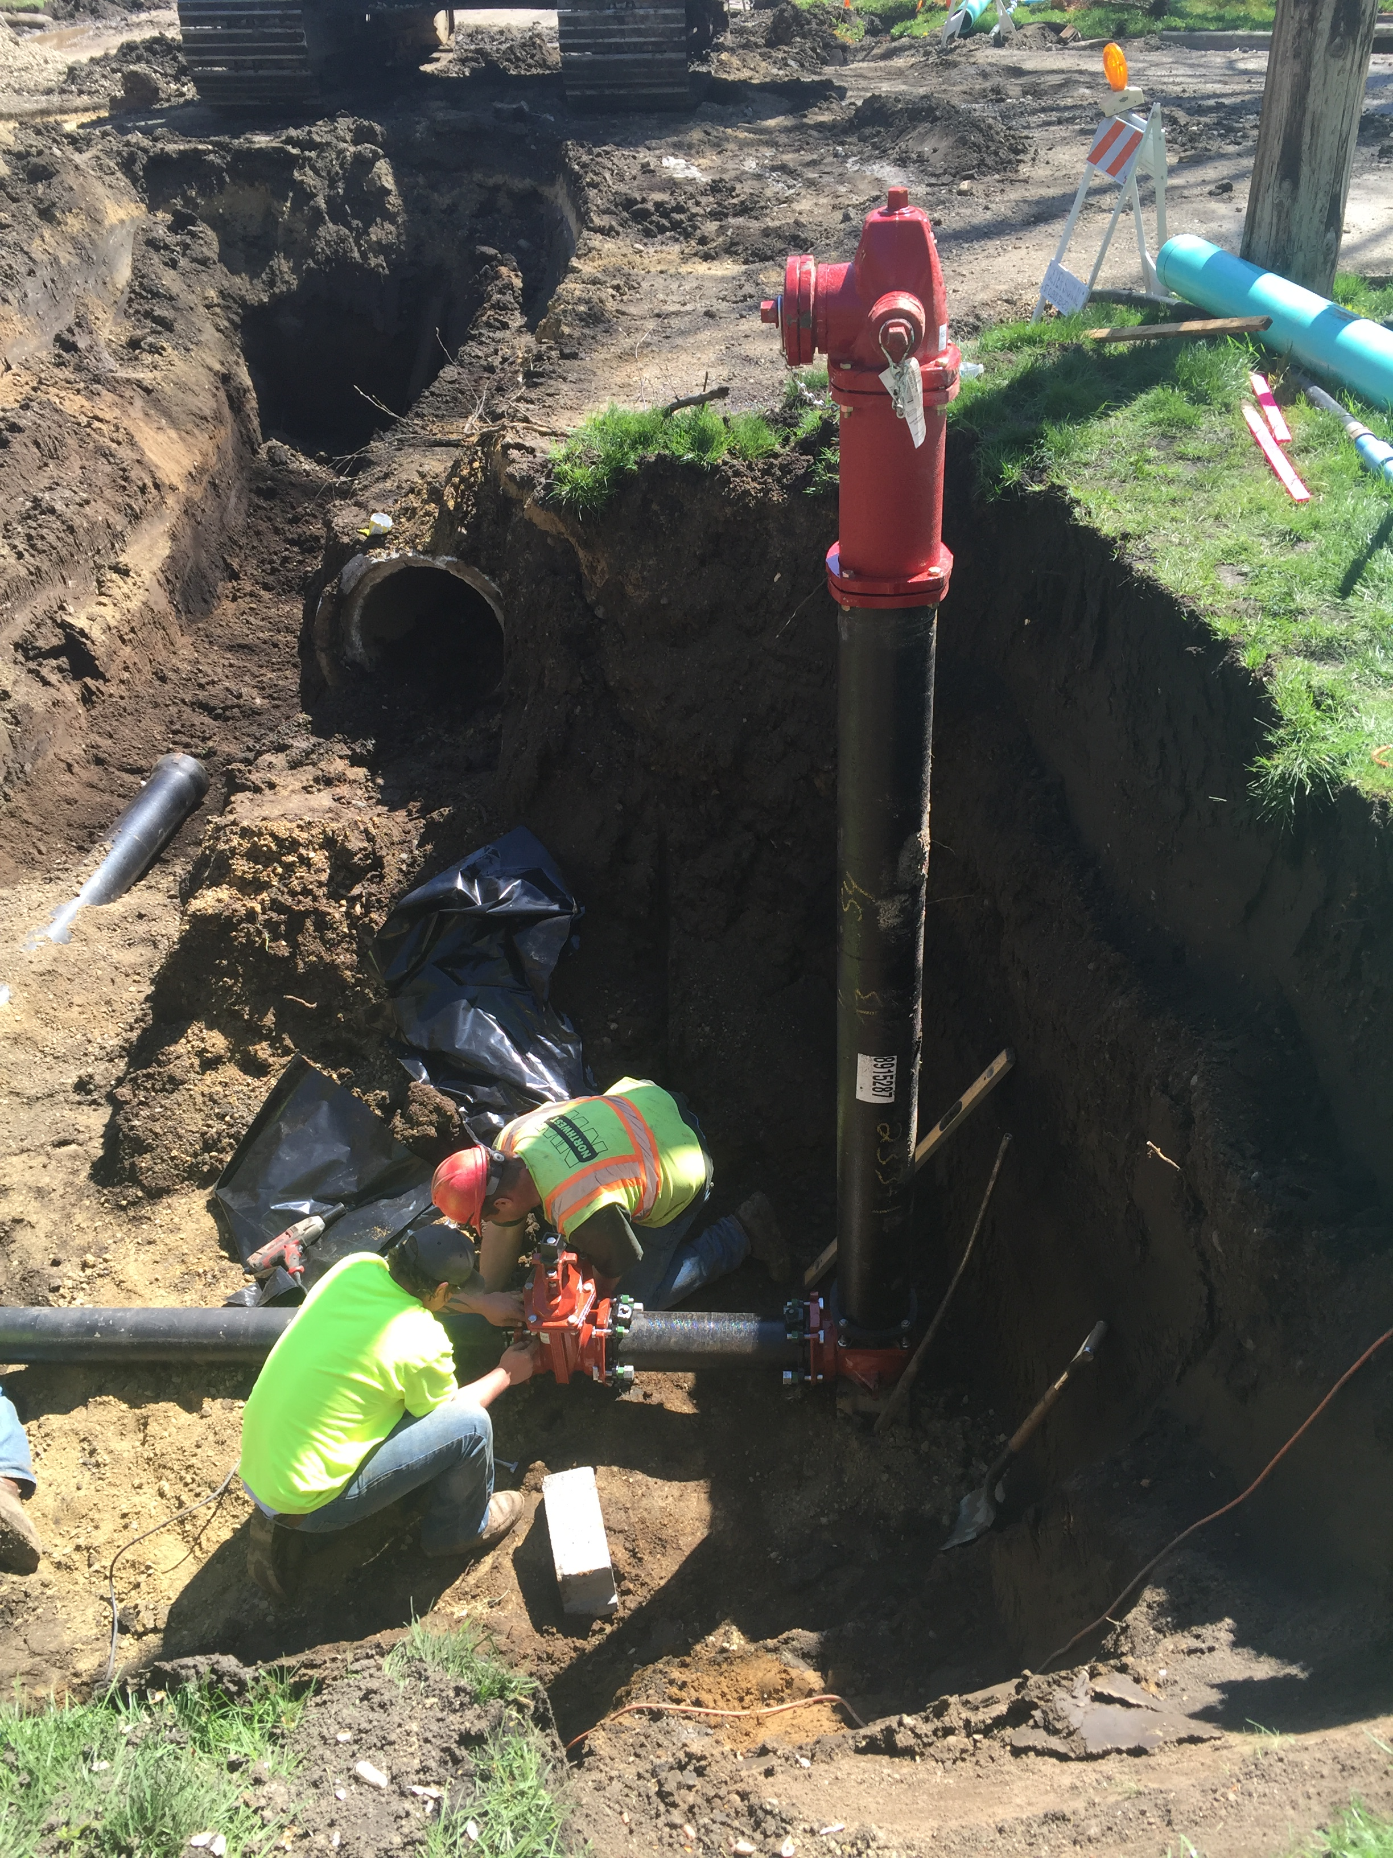
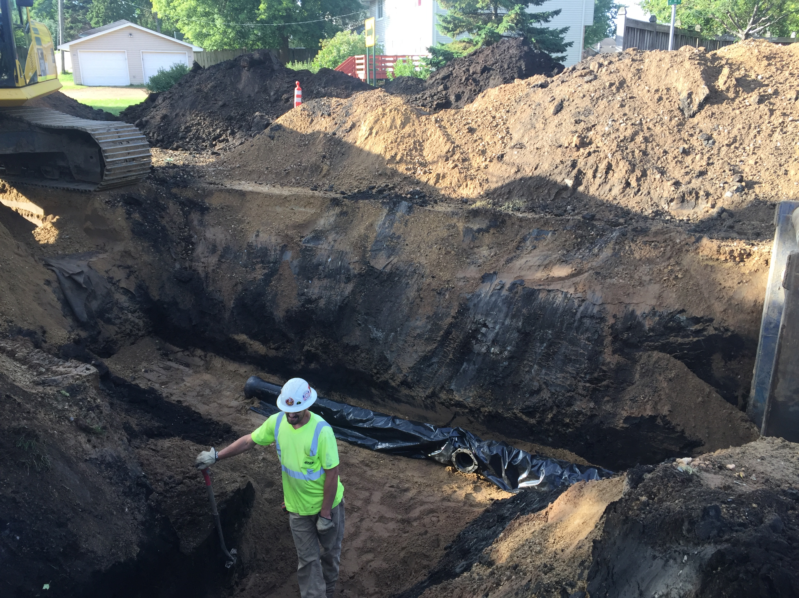
Watermain Improvements

Slide 10
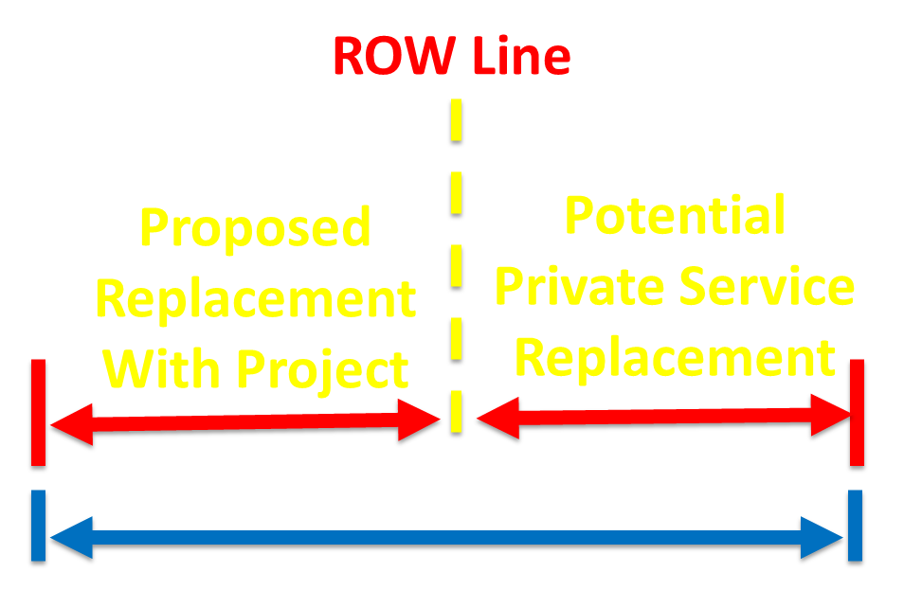
Service Line Replacements
Water & Sanitary Services to be replaced from City’s main (in the street) to the right-of-way/property line
Notes:
Optional. Requires signed waiver. Cost can be assessed to the property similar the special assessment.

Slide 11
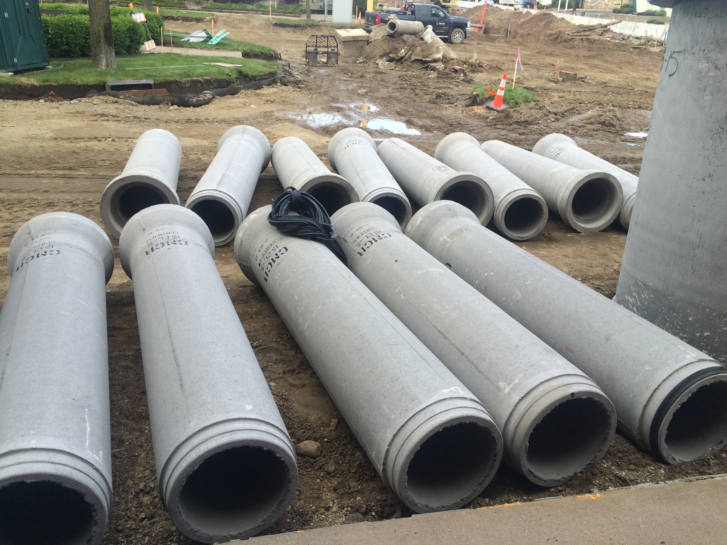
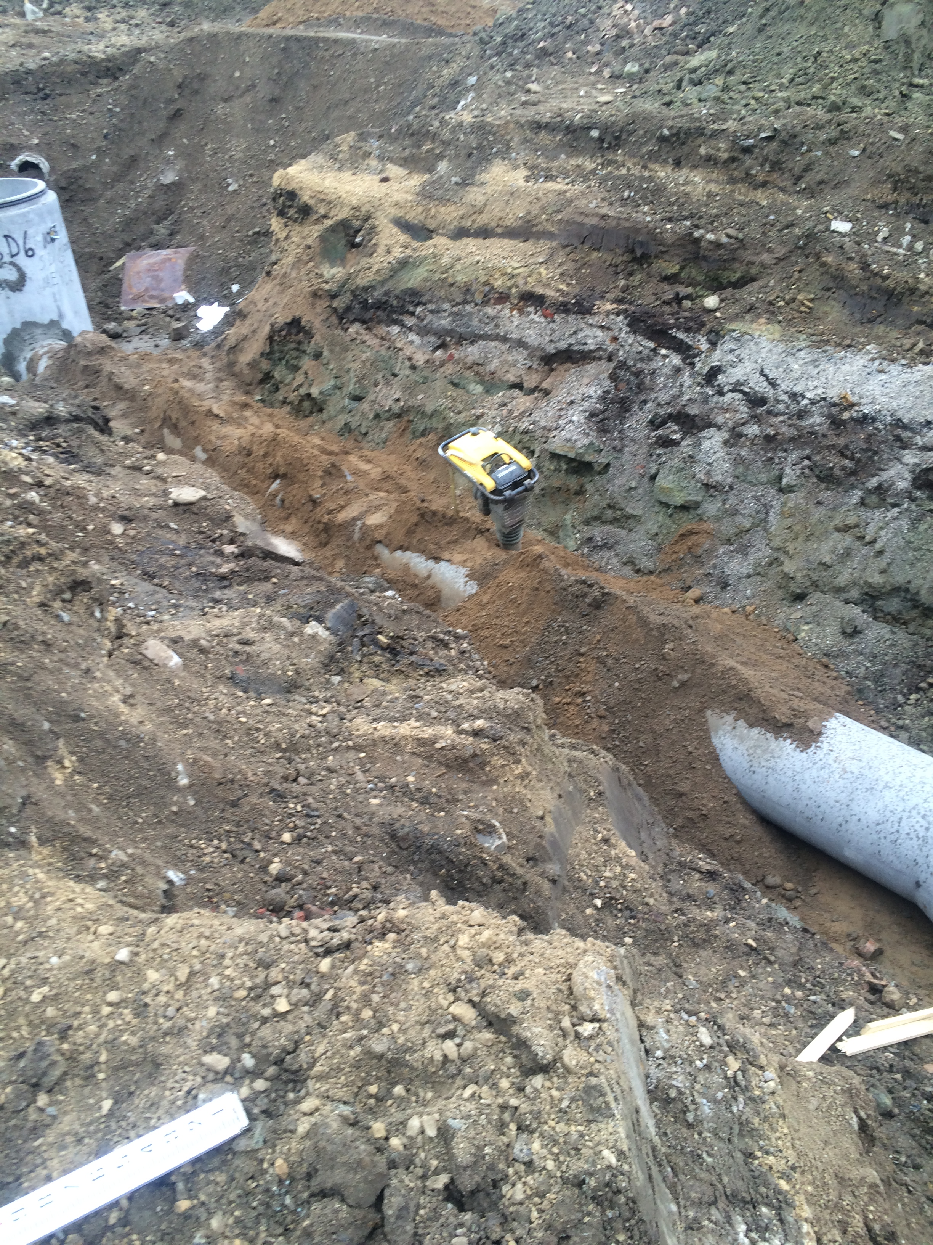
Storm Sewer Improvements

Slide 12
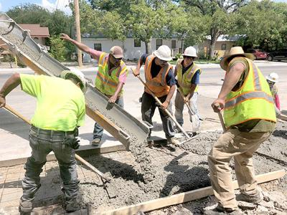
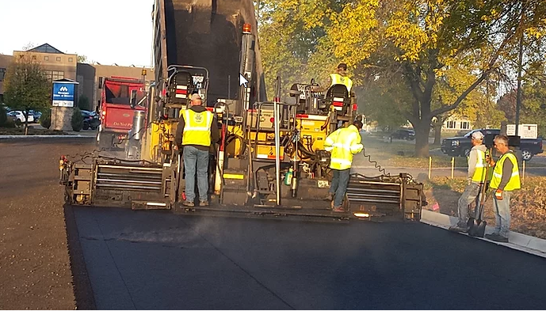
Roadway Improvements

Slide 13
Construction Process
Contractor “typical” sequencing in each block
4-5 weeks of utility construction (sanitary sewer, watermain, services & storm sewer)
3-4 weeks of street construction
1-2 weeks of boulevard restoration
Temporary Water Shutdowns – Temporary water system to be installed to maintain service during construction
Temporary Access Restrictions – No driveway access during active construction

Slide 14
Tree Removals
Boulevard Trees
Utility, Roadway and Sidewalk Conflicts
Health and Species
Located within the right-of-way
Trees to be removed will be marked with “pink” ribbon and delivered “green” door hangar ahead of time
Tree removal operation for entire corridor (all stages) planned to be completed at the same time

Slide 15
Roadway Improvements
N 4th Street
5” Bituminous Asphalt Pavement (3 separate lifts)
12” Aggregate Base
B618 Concrete Curb & Gutter
36’ street width typical – 11’ thru lanes + 7’ parking lanes (both sides)
Cathcart Street
4” Bituminous Asphalt Pavement (2 separate lifts)
10” Aggregate Base
B618 Concrete Curb & Gutter
30’ street width typical – 11’ thru lanes + 8’ parking lane (one side)

Slide 16
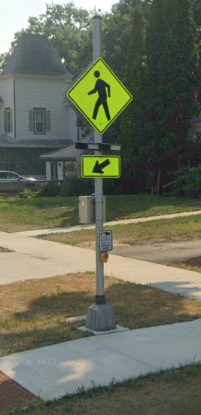
Pedestrian Improvements
N 4th Street
5’ concrete sidewalk continuous along west side to Peck St
5’ concrete sidewalk continuous along east side to Grove St
6’ concrete trail continuous along east side to Dakota St
Protecting existing concrete sidewalk where feasible
Cathcart Street
5’ concrete sidewalk continuous along south side
RRFB Crossings at Grove St and Dakota St
Boulevards
Organic topsoil and seed for turf restoration
Notes:
Trail and sidewalk on the opposite side of a trail will be City maintained for snow removal.

Slide 17
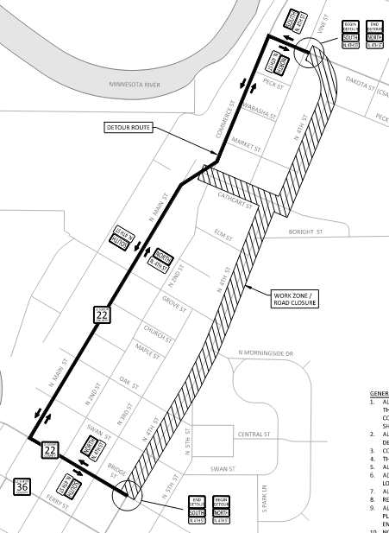
Detour Route
Detour route will be signed as N Main St (CSAH 22)
14-day closure of intersection of N 4th St and Dakata St (CSAH 35)

Slide 18
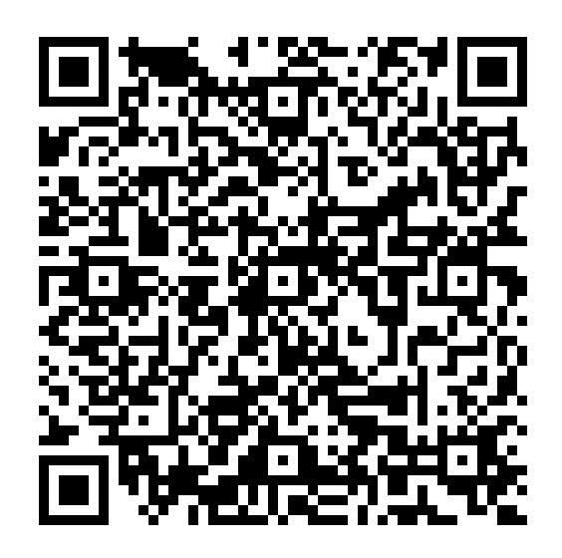
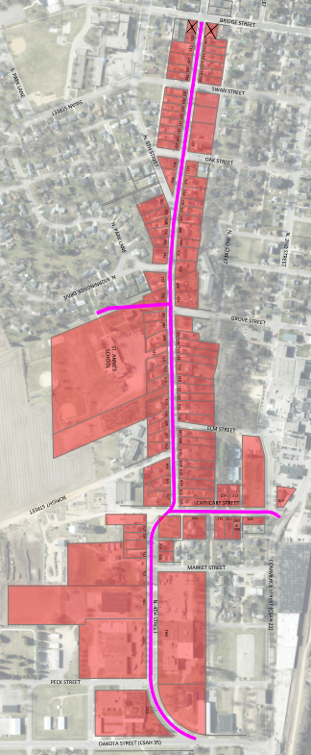
Special Assessments
Benefit Appraisals Completed (link to report on project website)
Draft Assessment Roll Mailed on November 1st (along with OH #2 invite)

Slide 19
Special Assessments
Tentative schedule:
August 11, 2025 – Call for Assessment Hearing *
August 11, 2025 – Order Preparation of Proposed Final Assessment Roll *
August 15, 2025 – Send Notice for Assessment Hearing to Henderson Independent
August 20, 2025 – Mail Notice for Assessment Hearing & Final Assessment Amount to property owners
August 21, 2025 – Notice for Assessment Hearing published in Henderson Independent
August 27, 2025 – Hold Neighborhood Assessment Public Information Meeting (Open House)
September 8, 2025 – Hold Special Assessment Hearing *
September 22, 2025 – City Council Adopt Final Assessment Roll *
By November 30, 2025 – Approve Certification of Assessment Roll & File with County Auditor
* At City Council Meeting

Slide 20
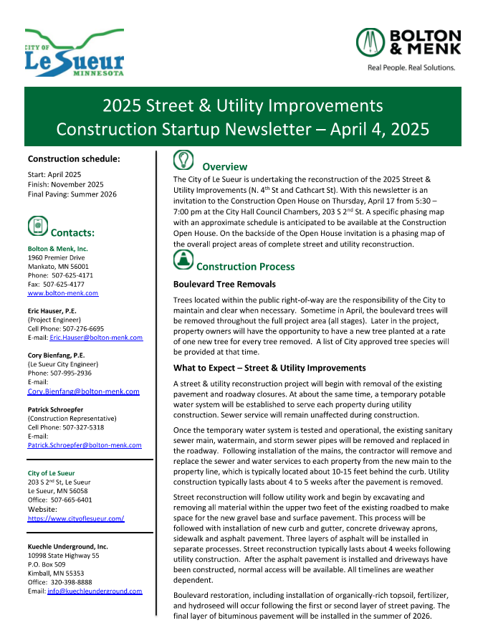
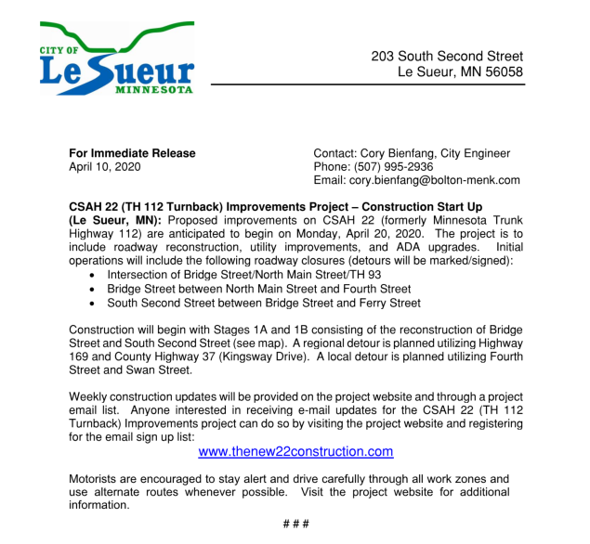
Communication During Construction
Newsletters (occasionally)
Press Releases (significant updates)

Slide 21
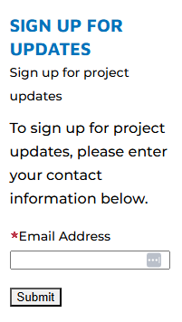
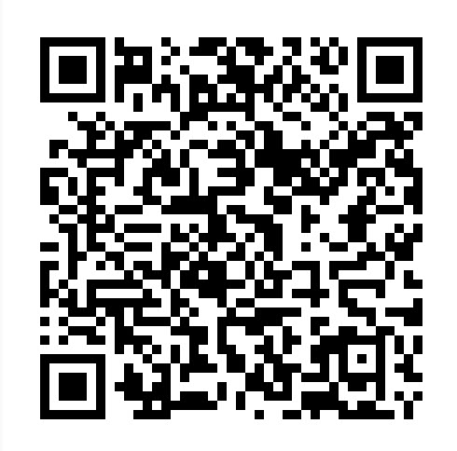
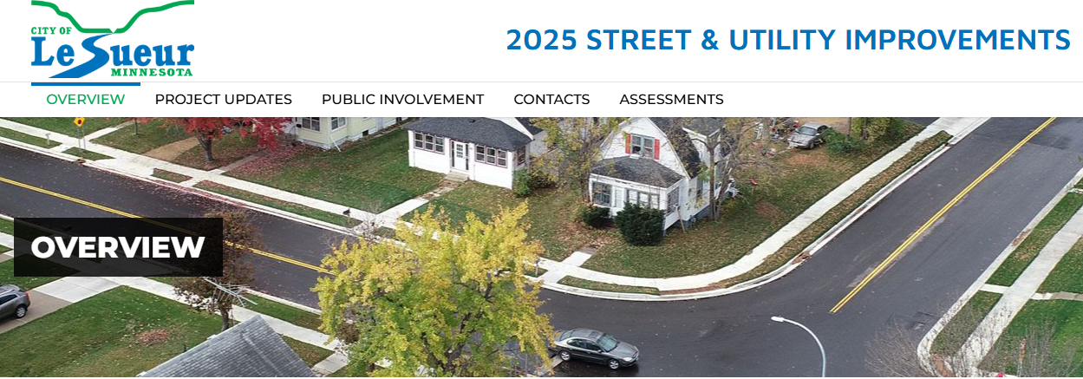
Communication During Construction
Email Updates (weekly)
Website

Slide 22
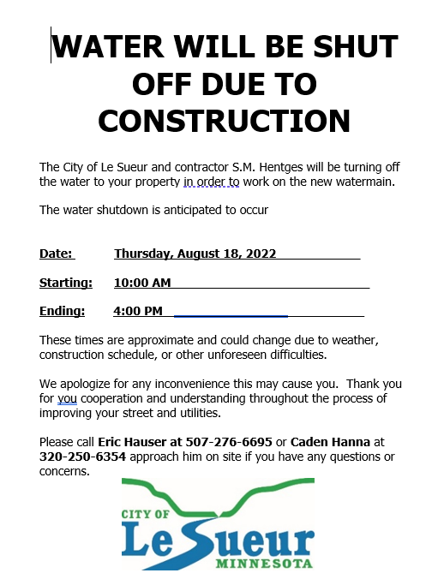
Communication During Construction
Notices “door hangers” (as needed)

Slide 23
Communication During Construction
On-Site Contact: Pat Schroepfer
(507) 327-5318
Patrick.Schroepfer@Bolton-menk.com
Project Engineer: Eric Hauser, P.E.
(507) 276-6695
eric.hauser@Bolton-menk.com
City Engineer: Cory Bienfang, P.E.
(507) 995-2936
cory.bienfang@Bolton-menk.com

Slide 24
Questions?

