Slide 1

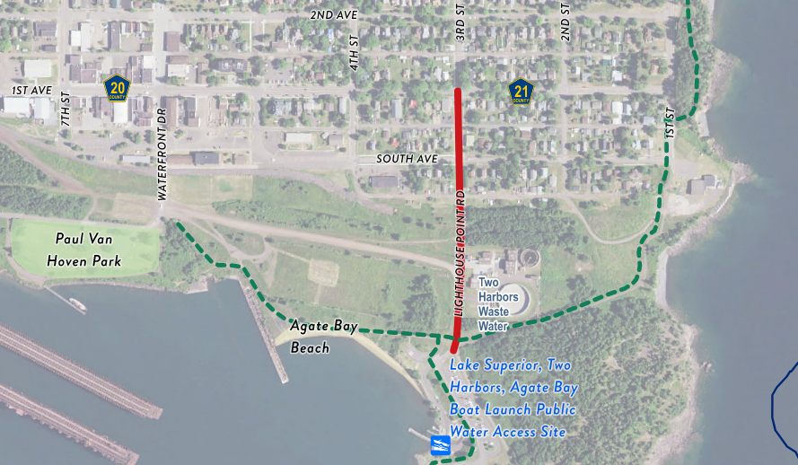
Lighthouse Point Road & 3rd Street Reconstruction – Public Improvement Hearing
Notes:
Update Project Name and date

Slide 2
Agenda
Proposed Improvements
Estimated Costs
Proposed Funding
Proposed Schedule

Slide 3
Overall Project Layout
Notes:
Update as necessary

Slide 4
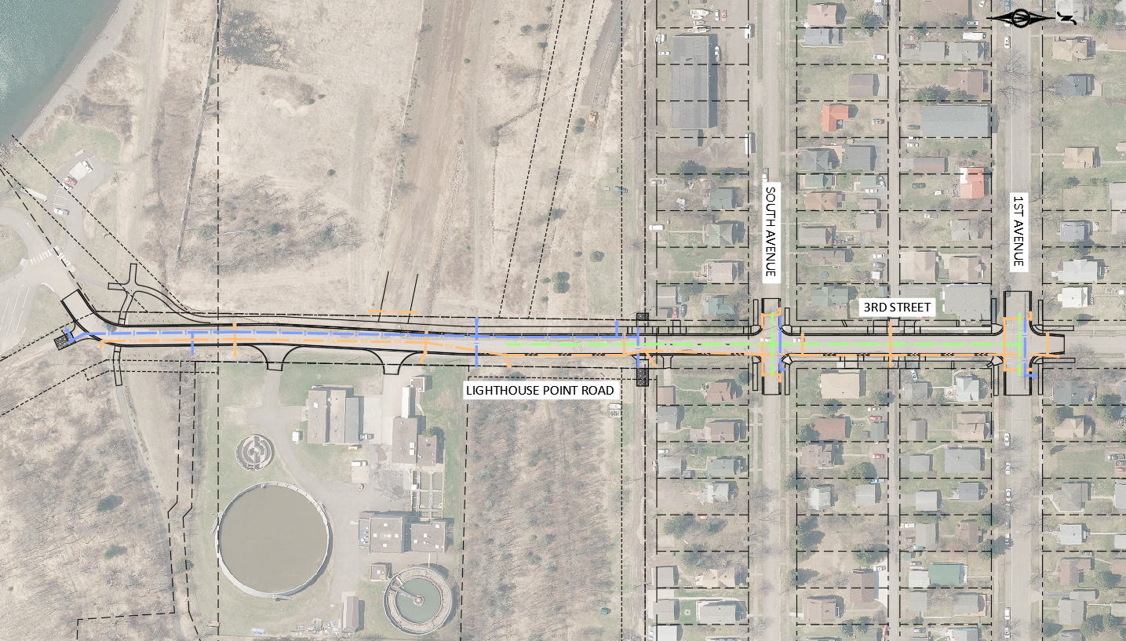
Proposed Utility Improvements
3rd Street & Lighthouse Point Road
SOUTH AVENUE
1ST AVENUE
3RD STREET
LIGHTHOUSE POINT ROAD

Slide 5
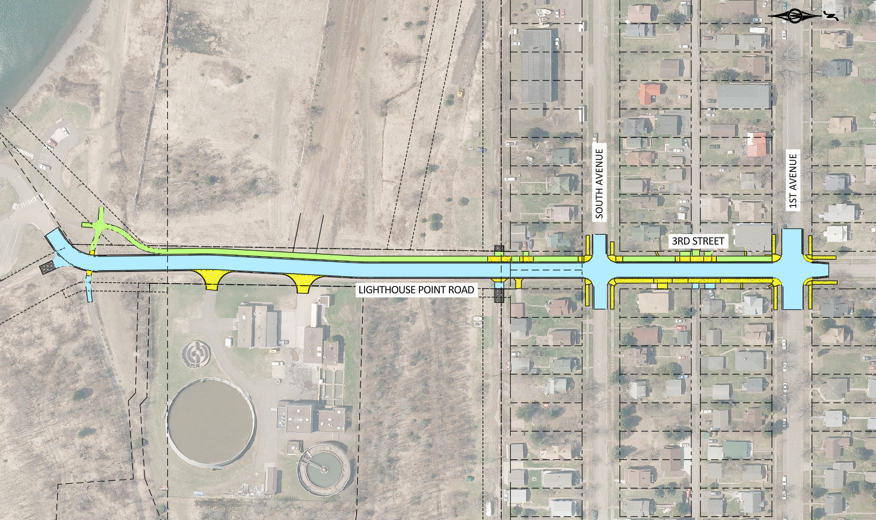
Proposed Street Improvements
3rd Street & Lighthouse Point Road

Slide 6
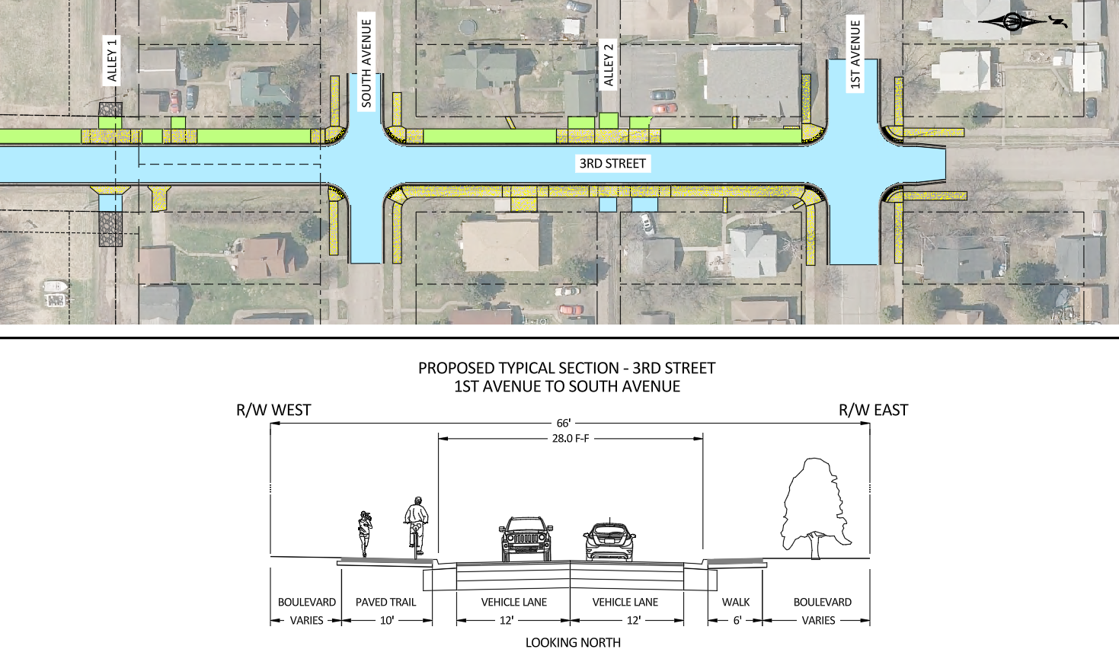

Proposed Improvements – 3rd Street

Slide 7
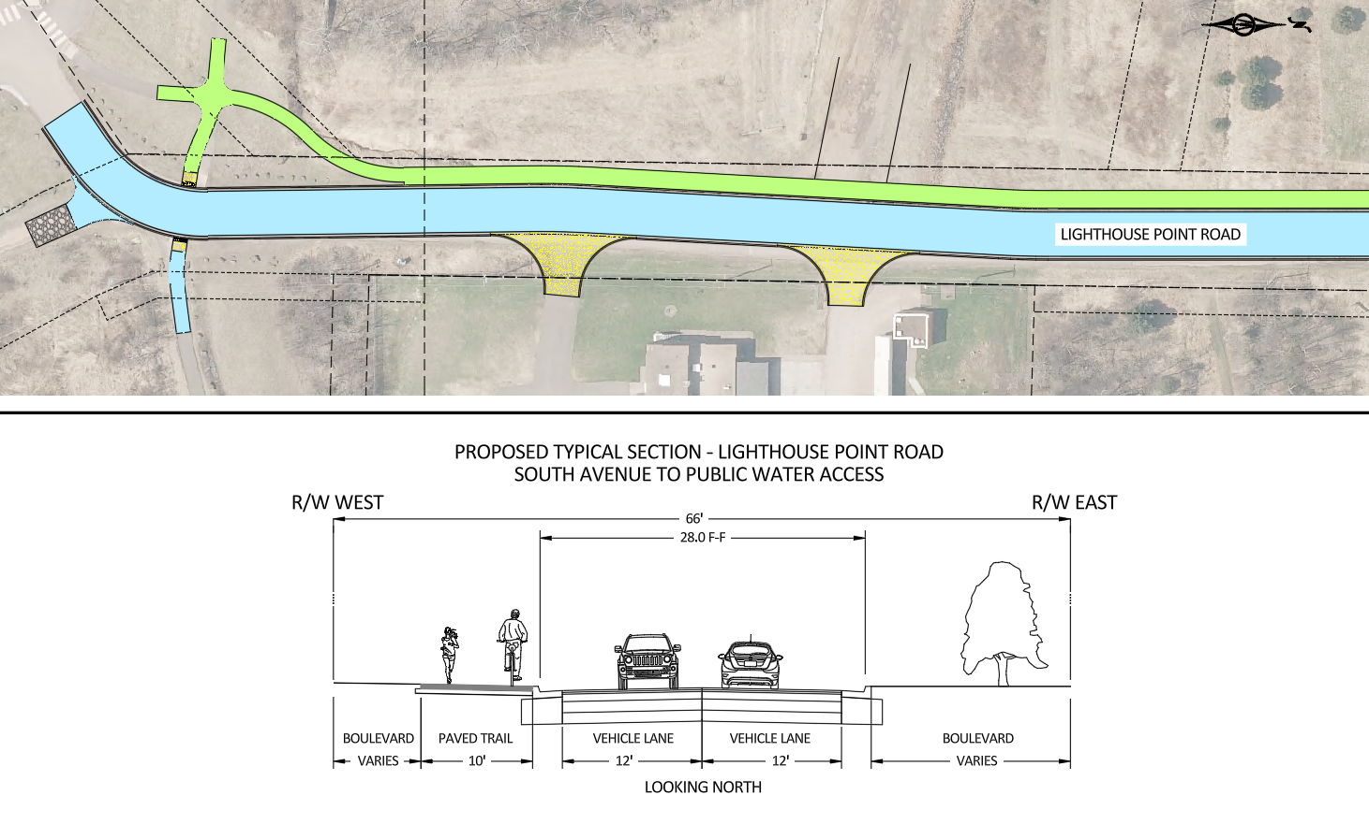
Proposed Improvements – LHP Road

Slide 8
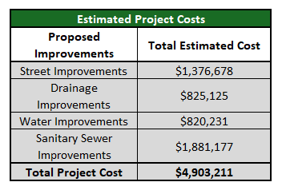
Project Cost and Funding
Notes:
Update with project specific information

Slide 9
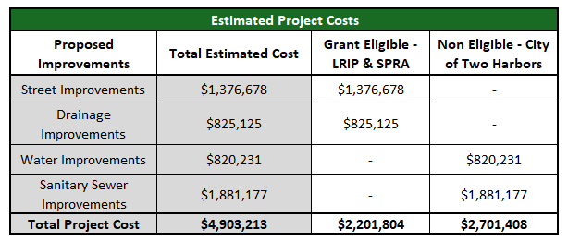
Project Cost and Funding

Slide 10
City Assessment Policy
Term of assessment - 15 years for bituminous street and sidewalk
Assessment method - Front Footage Method
For properties that are corner lots, assessments shall be based on 50% of the cost for the street which the property is addressed to, and 15% of the cost for the side lot street frontage.
$50 per square (5'x5') for walks
New Main Line Sewer and Water - 100% of cost assessed to property Owner/Developer

Slide 11
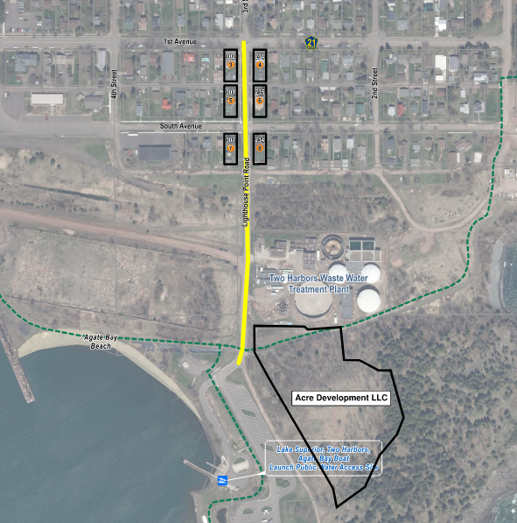
Proposed Project Assessments
Notes:
Update based on project specific information

Slide 12
Proposed Project Assessments
Method of assessment proposed:
  Total project front footage = 2,888 FT
  Total estimated street cost = $1,077,498
  Assessable cost – 15% = $161,625
  Front footage assessment = $161,625 / 2,888 FT = $55.96/FF
  Sidewalk area per parcel = 25 square feet
  Total sidewalk assessment per parcel = 25 SF x $50 = $1,250
Notes:
Update based on project specific information

Slide 13
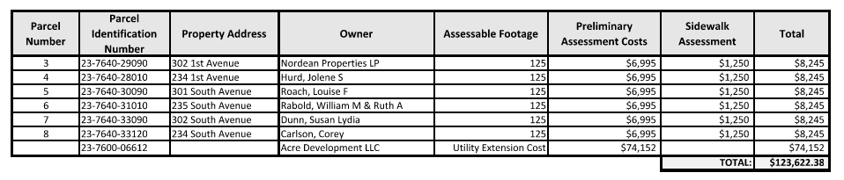
Preliminary Assessment Roll

Slide 14
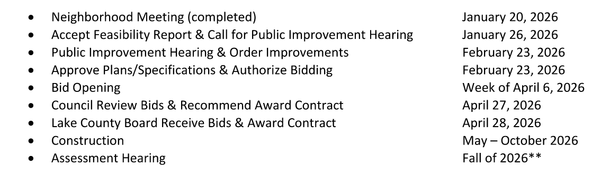
Proposed Project Schedule
Notes:
Highlight public improvement line & approve plans line

Slide 15




Questions?
Website
Lighthousepointreconstruction.com
Email
info@lighthousepointreconstruction.com
Email Updates
Lighthousepointreconstruction.com
Help Line
507-613-8905

Slide 16
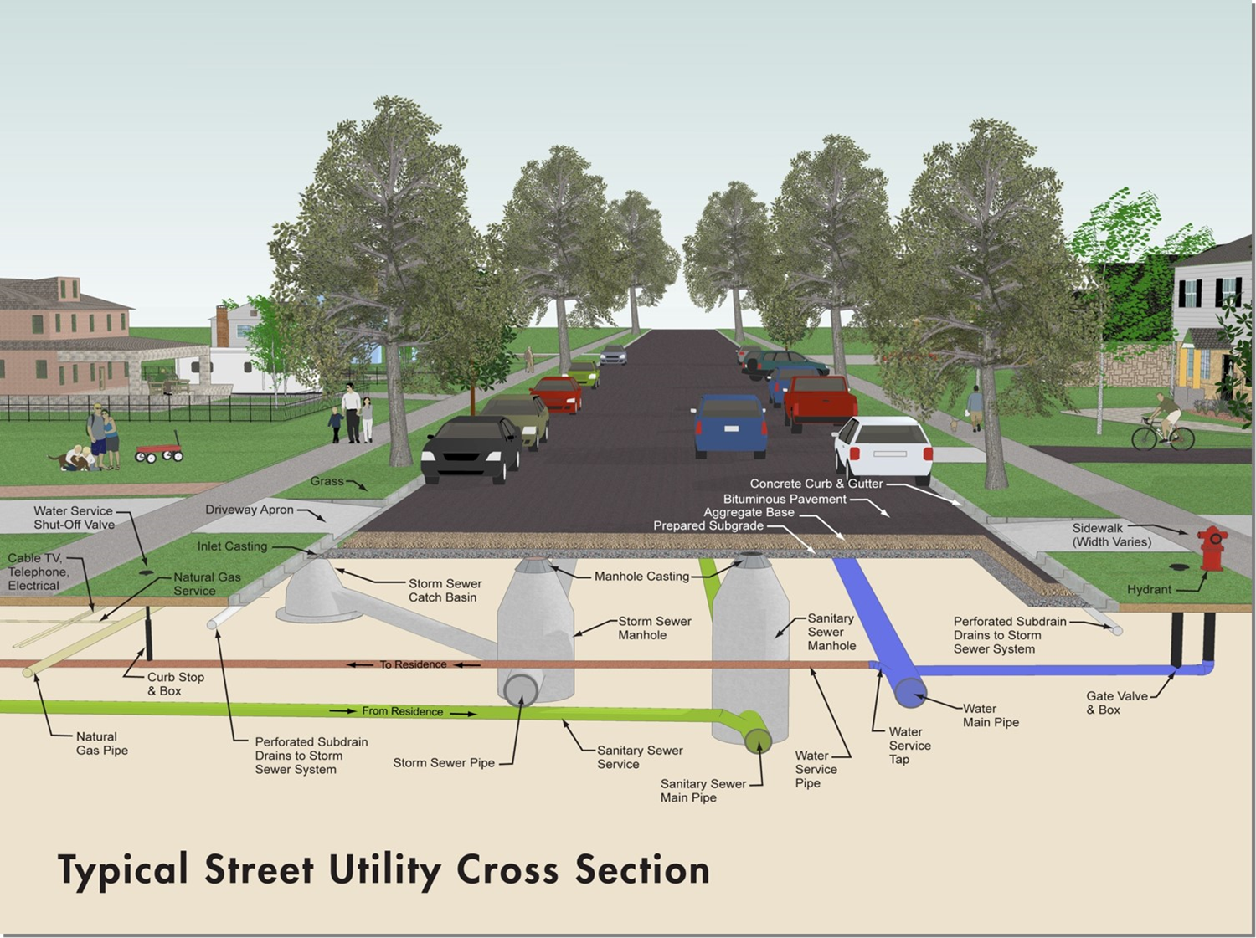
Proposed Improvements
What is under a typical street?

