Slide 1
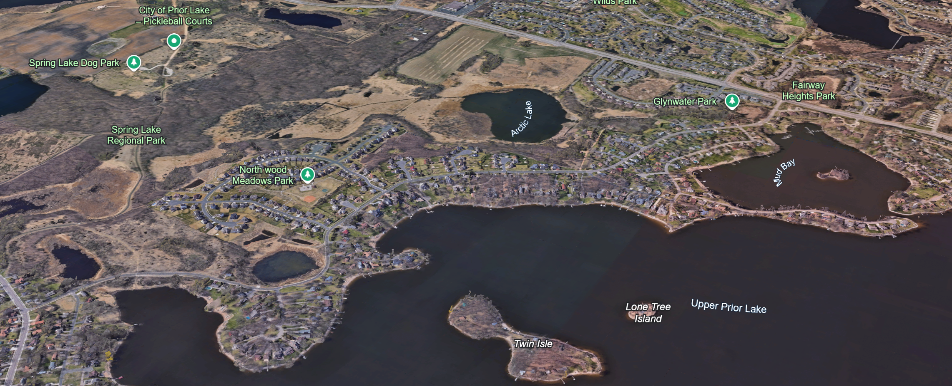

Northwood Road Area Street & Utility Improvements
Phase 1
Public Assessment Hearing
March 10th, 2026

Slide 2
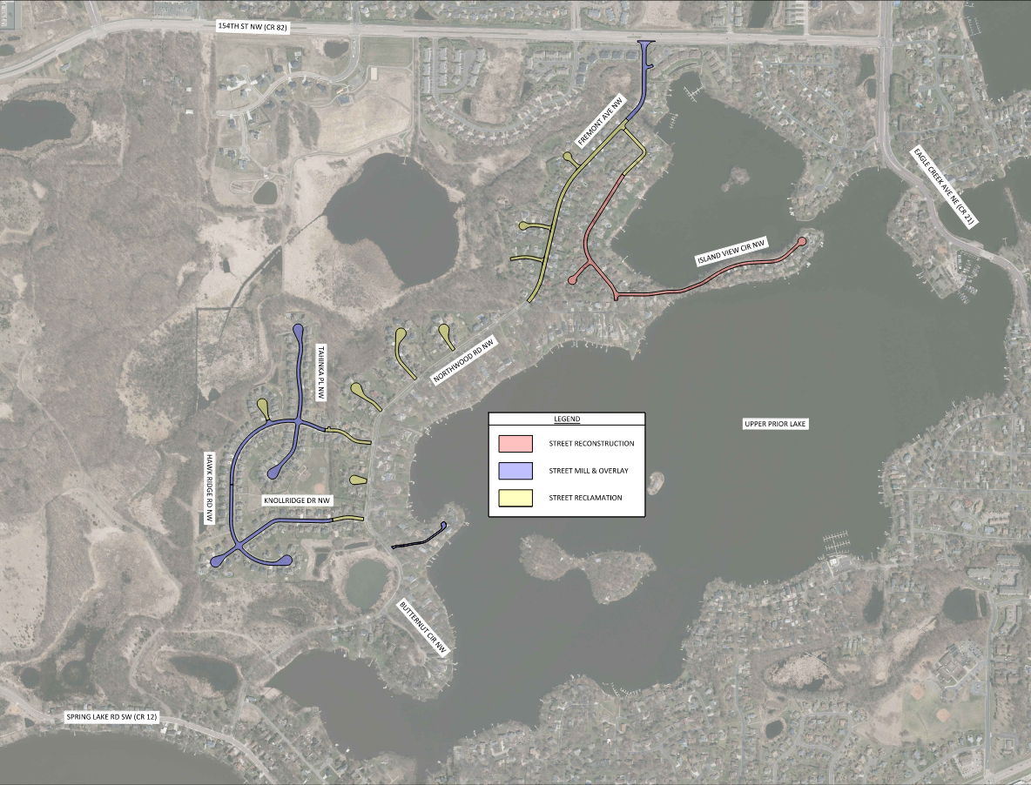
Project Overview & Location
Existing Conditions:
Existing pavement is in poor condition – varies by street
Concrete curb and gutter on some streets but not on others
Gap in pedestrian facilities along Fremont Ave
Storm Sewer, Sanitary Sewer, and Watermain is in variable condition based on materials and age
  Some public utilities are in backyard easements and boulevard areas
2

Slide 3
Public Engagement
Open
House #1
Open
House #2
Improvement Hearing
Ongoing Construction Communications
Open House #3/Assessment Hearing
MARCH 2025
AUGUST 2025
SEPT. 2025
APR – NOV
2026
MARCH 2026
The feasibility stage of the project included Phases 1-3 together, through the Improvement Hearing. Each phase of the project will progress independently through final design, Assessment Hearing, and construction, based on the identified construction year.
3

Slide 4
Project Costs & Funding
As-Bid Estimated Project Costs
Proposed Improvements | Estimated Project Costs
Street Improvements | $5,785,048.09
Storm Sewer Improvements | $600,490.00
Sanitary Sewer Improvements | $1,631,919.30
Watermain Improvements | $1,161,637.36
Total Project Costs | $9,179,094.75
4

Slide 5
Project Costs & Funding
Estimated Funding Breakdown
Funding Source | Estimated Funding Costs
Ad Valorem Tax | $1,240,545.44
Assessments | $1,387,280.00
Franchise Fees | $1,948,000.00
Utility Fund – Storm Sewer | $600,490.00
Utility Fund – Sanitary Sewer | $1,631,919.30
Utility Fund - Water | $1,161,637.36
PIR | $972,126.65
PIR Assessment | $237,096.00
Total Project | $9,179,094.75
5

Slide 6
Project Assessments
Prior Lake Special Assessment Policy for Public Improvements
Residential Equivalent Unit (REU) Basis
  Each property’s REU is determined based on the maximum dwelling units for the property multiplied by the applicable factor for the property use
    Single-Family properties carry a factor of 1
    Townhome properties carry a factor of 0.75
40% of street improvement costs are assessed for Reclamation and Reconstruction projects
Mill & Overlay projects are assessed at the rate adopted in the current Fee Schedule
Reclamation and Reconstruction projects are assessed over a 10-year period
Mill & Overlay projects are assessed over a 5-year period
The interest rate is set 2.0% higher than the most recent sale of City bonds
6

Slide 7
Project Assessments
Proposed Final Assessments
*Reconstruction Assessment: $14,000 per SF home
**Reclamation Assessment: $5,680 per SF home
***Mill & Overlay Estimated Fee Schedule Assessment: $1,602 per SF home
$1,201.50 per TH
* Assessment amount based on Assessment Review Committee recommendation from Benefit Appraisal.
** Assessment amount calculated based on as-bid project costs.
*** Assessment based on the adopted fee schedule of the construction year (2026).
7

Slide 8
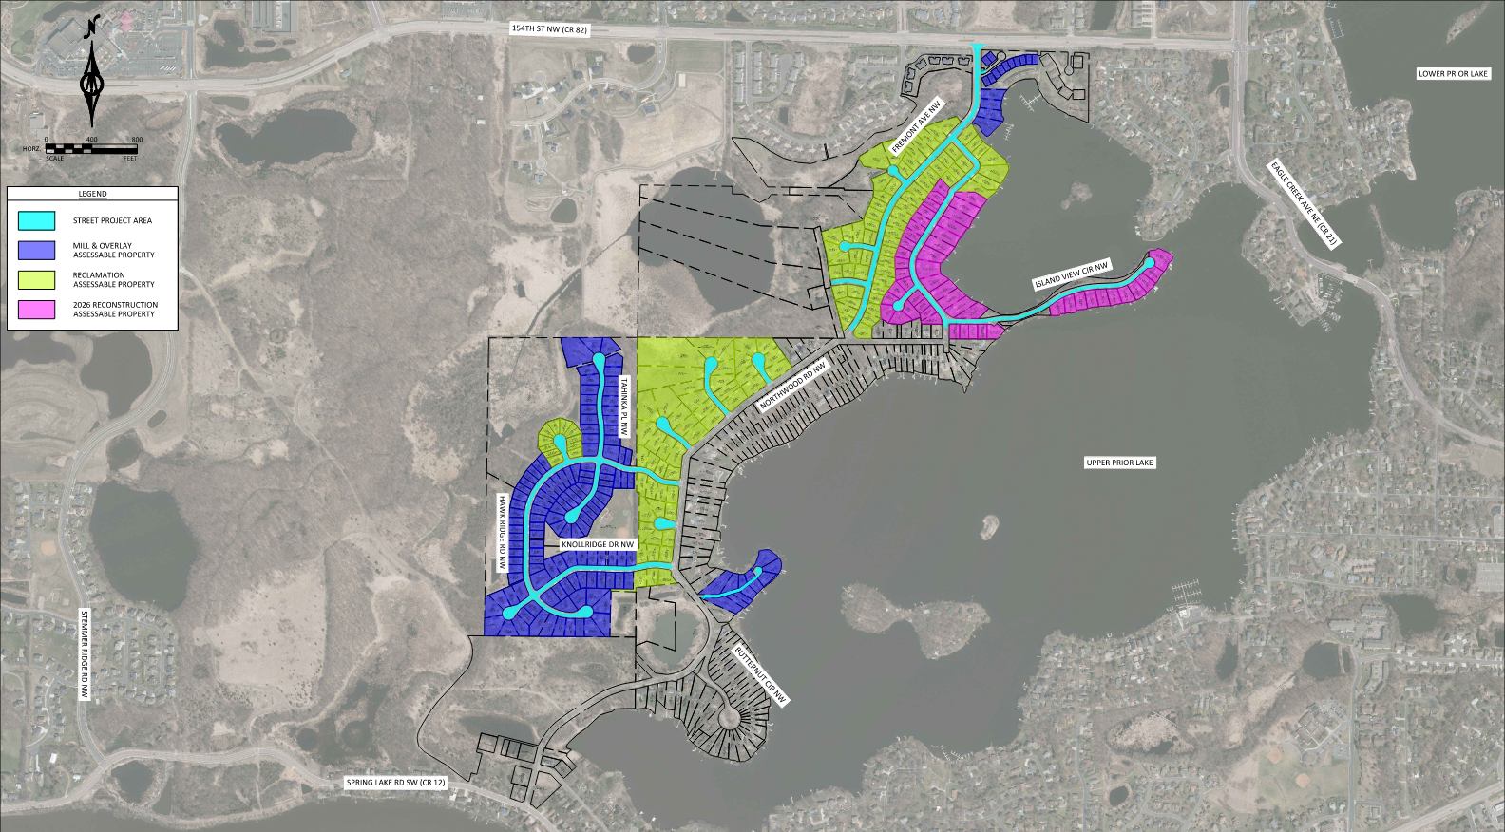
Project Assessments Map
8

Slide 9
Sample Assessment Payment Schedule
Reconstruction (per SF home)
Unit Amount |  | Unit Amount | $14,000
Term (Years) |  | Term (Years) | 10 | Years
APR |  | APR | 5.75%
First Year Interest |  | First Year Interest | 296 | Days
Pmt # | Year | Principal | Interest | Annual Payment | Remaining Principal
Beginning Balance |  | Beginning Balance |  |  | $14,000.00
1 | 2027 | $1,400.00 | $1,457.82 | $2,857.82 | $12,600.00
2 | 2028 | $1,400.00 | $724.50 | $2,124.50 | $11,200.00
3 | 2029 | $1,400.00 | $644.00 | $2,044.00 | $9,800.00
4 | 2030 | $1,400.00 | $563.50 | $1,963.50 | $8,400.00
5 | 2031 | $1,400.00 | $483.00 | $1,883.00 | $7,000.00
6 | 2032 | $1,400.00 | $402.50 | $1,802.50 | $5,600.00
7 | 2033 | $1,400.00 | $322.00 | $1,722.00 | $4,200.00
8 | 2034 | $1,400.00 | $241.50 | $1,641.50 | $2,800.00
9 | 2035 | $1,400.00 | $161.00 | $1,561.00 | $1,400.00
10 | 2036 | $1,400.00 | $80.50 | $1,480.50 | $0.00
Totals |  | $14,000.00 | $5,080.32 | $19,080.32
9

Slide 10
Sample Assessment Payment Schedule
Reclamation (per SF home)
Unit Amount |  | Unit Amount | $5,680
Term (Years) |  | Term (Years) | 10 | Years
APR |  | APR | 5.75%
First Year Interest |  | First Year Interest | 296 | Days
Pmt # | Year | Principal | Interest | Annual Payment | Remaining Principal
Beginning Balance |  | Beginning Balance |  |  | $5,680.00
1 | 2027 | $568.00 | $591.46 | $1,159.46 | $5,112.00
2 | 2028 | $568.00 | $293.94 | $861.94 | $4,544.00
3 | 2029 | $568.00 | $261.28 | $829.28 | $3,976.00
4 | 2030 | $568.00 | $228.62 | $796.62 | $3,408.00
5 | 2031 | $568.00 | $195.96 | $763.96 | $2,840.00
6 | 2032 | $568.00 | $163.30 | $731.30 | $2,272.00
7 | 2033 | $568.00 | $130.64 | $698.64 | $1,704.00
8 | 2034 | $568.00 | $97.98 | $665.98 | $1,136.00
9 | 2035 | $568.00 | $65.32 | $633.32 | $568.00
10 | 2036 | $568.00 | $32.66 | $600.66 | $0.00
Totals |  | $5,680.00 | $2,061.16 | $7,741.16
10

Slide 11
Sample Assessment Payment Schedule
Mill & Overlay (per SF home)
Unit Amount |  | Unit Amount | $1,602
Term (Years) |  | Term (Years) | 5 | Years
APR |  | APR | 5.75%
First Year Interest |  | First Year Interest | 296 | Days
Pmt # | Year | Principal | Interest | Annual Payment | Remaining Principal
Beginning Balance |  | Beginning Balance |  |  | $1,602.00
1 | 2027 | $320.40 | $166.82 | $487.22 | $1,281.60
2 | 2028 | $320.40 | $73.69 | $394.09 | $961.20
3 | 2029 | $320.40 | $55.27 | $375.67 | $640.80
4 | 2030 | $320.40 | $36.85 | $357.25 | $320.40
5 | 2031 | $320.40 | $18.42 | $338.82 | $0.00
Totals |  | $1,602.00 | $351.05 | $1,953.05
11

Slide 12
Sample Assessment Payment Schedule
Mill & Overlay (per Townhome)
Unit Amount |  | Unit Amount | $1,201.50
Term (Years) |  | Term (Years) | 5 | Years
APR |  | APR | 5.75%
First Year Interest |  | First Year Interest | 296 | Days
Pmt # | Year | Principal | Interest | Annual Payment | Remaining Principal
Beginning Balance |  | Beginning Balance |  |  | $1,201.50
1 | 2027 | $240.30 | $125.11 | $365.41 | $961.20
2 | 2028 | $240.30 | $55.27 | $295.57 | $720.90
3 | 2029 | $240.30 | $41.45 | $281.75 | $480.60
4 | 2030 | $240.30 | $27.63 | $267.93 | $240.30
5 | 2031 | $240.30 | $13.82 | $254.12 | $0.00
Totals |  | $1,201.50 | $263.28 | $1,464.78
12

Slide 13
Important Assessment Dates
March 10, 2026 | Notice of intent to appeal must be submitted in writing.
November 2, 2026 | Full or partial payments by this date without interest.
November 3, 2026 | Special Assessments will be certified to Scott County and will include interest for 296 days in 2026 (first year interest) and for the entire following year (2027).
2027 to 2036 | Annual assessment payments due with property taxes. Half of the total annual payment is due in May and the other half in October or November (depending on the property classification).
13

Slide 14





Questions?
Website
clients.bolton-menk.com
/priorlakenorthwoodroad
Email
info@northwood
roadimprovements.com
Email Updates
clients.bolton-menk.com
/priorlakenorthwoodroad
Help Line
952-392-9631
Help Line
952-373-0176
14

Slide 15
City Council Action
Motion and second to:
  Approve a resolution adopting the assessment roll for the Northwood Road Area Project – Phase 1 (2026-01)
  Adopt a resolution receiving bids and awarding the contract for the Northwood Road Area Project – Phase 1 (2026-01)
15

