Slide 1
Randolph Sanitary Sewer Project
Special Council Meeting February 24th

Slide 2
SCHEDULE
Open House – March 30th & 31st, 2022
Accept Feasibility Report / Order Plans & Specs – May 25, 2022*
Develop Plans and Specifications – May – January 2022
Finalize Plans and Specifications – February 2023
Approve Plans and Authorize to Bid – February 24th, 2023*
Open Bids – March 2023
Award Bid– April 2023*
Open House (What to Expect During Construction) – April/May 2023
2023 Construction - May 2023 – October 2023
2024 Construction - May 2024 – October 2024

Slide 3
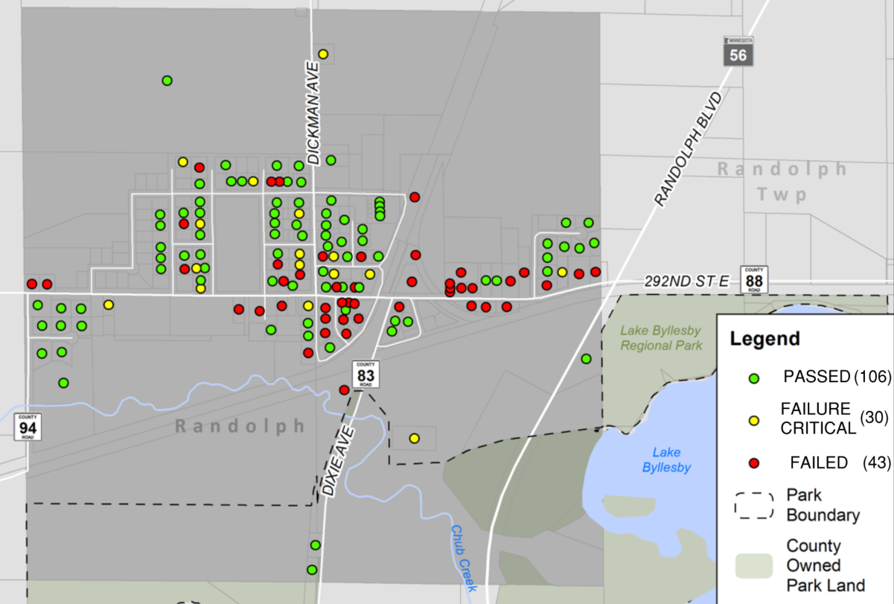
HOW DID WE GET HERE?
Existing failing septic systems
Old Zoning Practices didn’t account for a secondary septic site
October 2020 Bonding Bill
City Council Accepted Bond at November 19th Special Council Meeting
County Project on CSAH 88
Field Survey & Questionnaires
March Open House
Feasibility Report May 25th

Slide 4
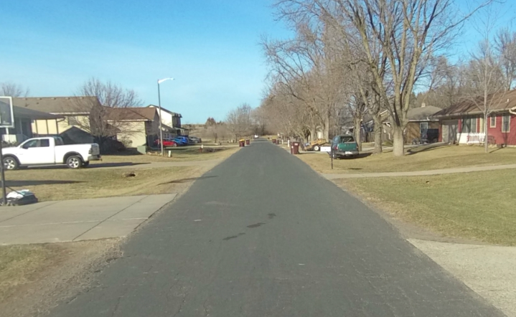
EXISTING CONDITIONS
Typically 20’ Wide Roadway
No formal storm sewer
Ditches & culverts, relies on infiltration into ground
Watermain installed in 1978
Unlocatable, plans based off Asbuilts
Typically 6”

Slide 5
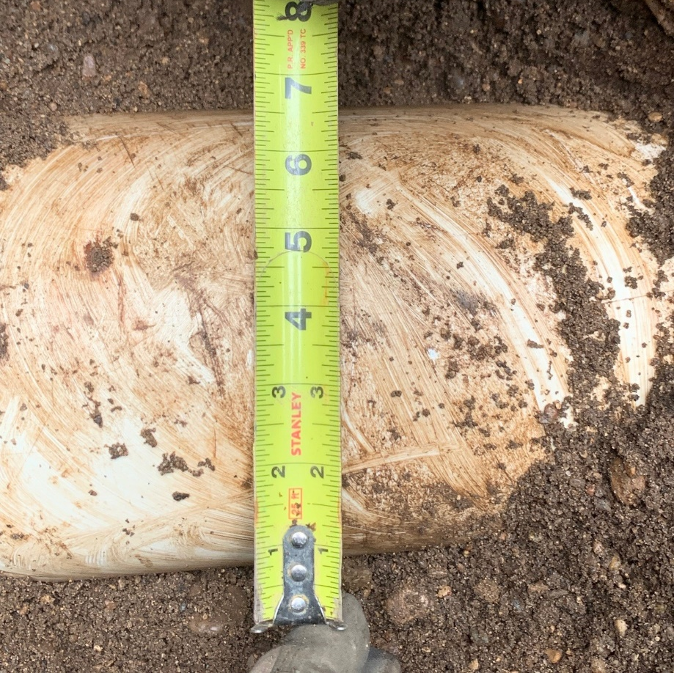
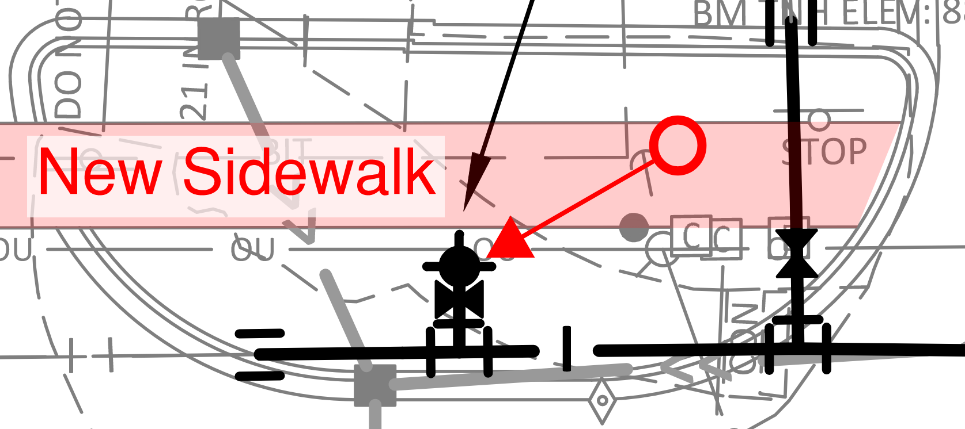
WATERMAIN
Replacement Cost is Approximately $3.6 million
Impact to Taxes would be approx. $1,385/Yr per property
Watermain replacement is NOT proposed with project
Contractor will be required to pothole watermain prior to beginning work
Some spot replacement to relocated hydrants on CSAH 88

Slide 6
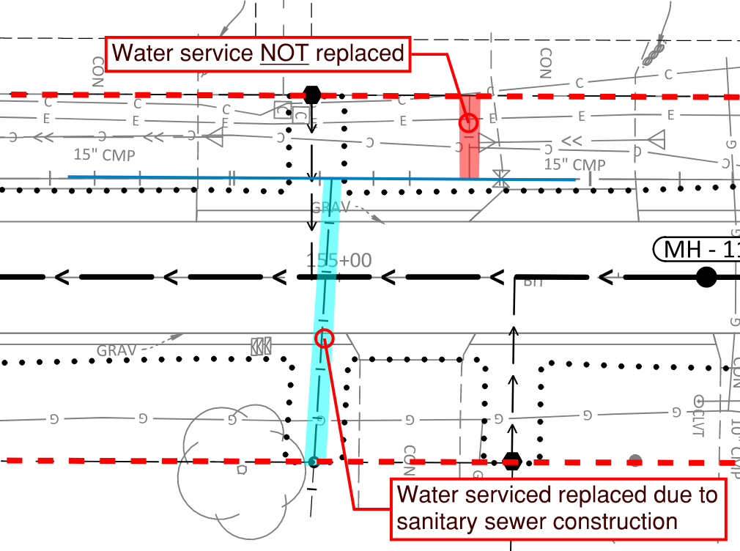
WATER SERVICES
Water services impacted by installation of Sanitary sewer will be replaced to ROW
During construction, all homes will be placed on temporary water system
Only short-term water outages are expected

Slide 7
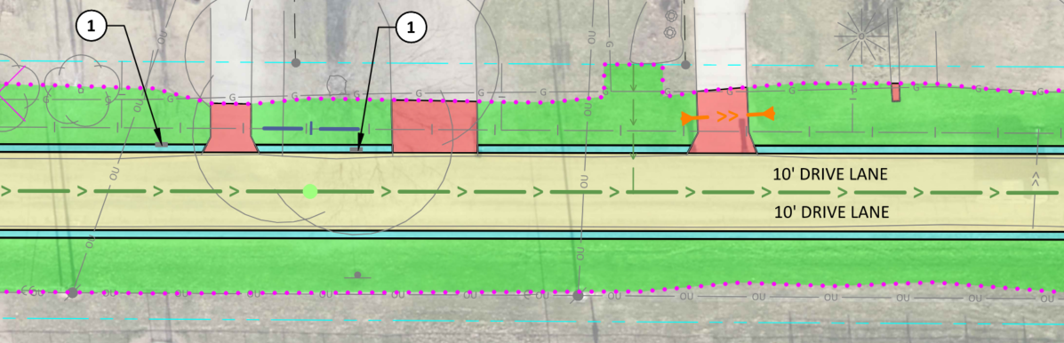
SANITARY SEWER IMPROVEMENTS
Sanitary Sewer in Street 10’-20’ deep
Sewer Services Stubbed to Approx. ROW
Flows to city hall parking lot, Pumped to Stabilization Ponds

Slide 8
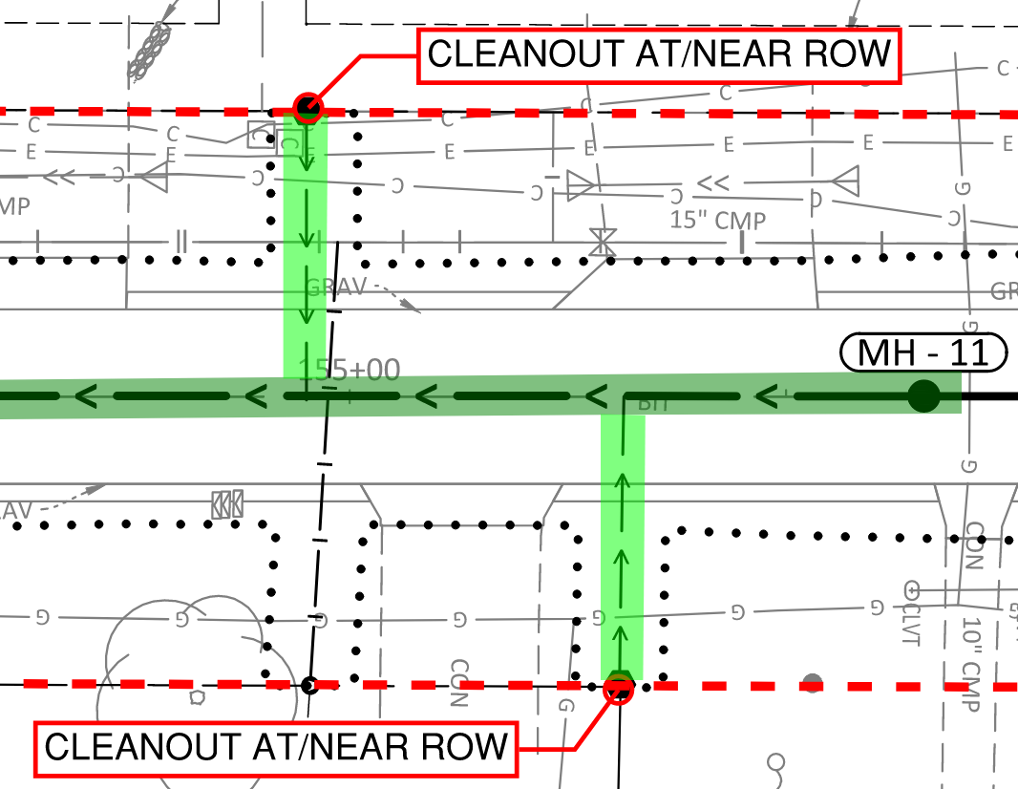
Sanitary Sewer Services
ROW LINE
Service Stub with Project
Homeowner Connection
Only properties with a failing septic system will be required to connect
Connections Beginning in 2024
Notification in the mail when system is tested & ready
County Assistance Program
Full Service Owned by Property

Slide 9
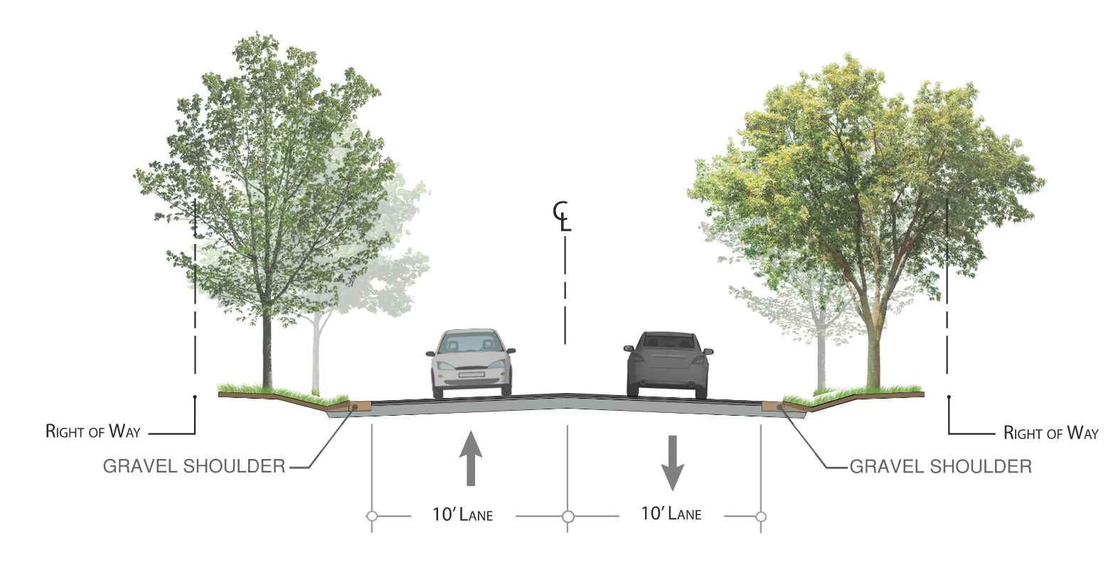
STORM SEWER – CITY
Installation of City-wide storm sewer cost is Approx $3.6 million
Impact to Taxes would be $1,385/Yr per property
Storm sewer on local streets is NOT proposed
Curb and gutter NOT proposed
Some drainage nuisances will still exist

Slide 10
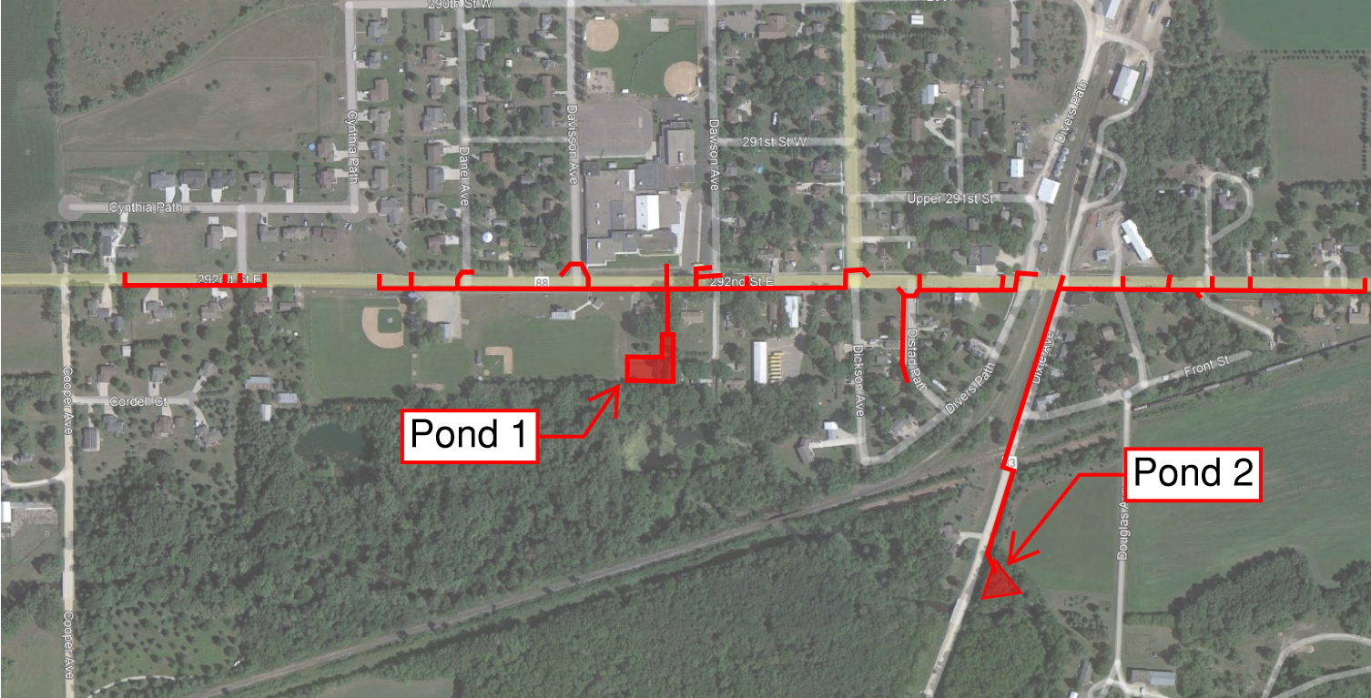
STORM SEWER – CSAH 88

Slide 11
LOCAL STREET IMPROVEMENTS
City streets will match the existing width(20’ min)
No curb & gutter is proposed
Reinstate the existing swales and ditches
Sidewalks impacted by project will be replaced
Existing signs will be reinstalled

Slide 12
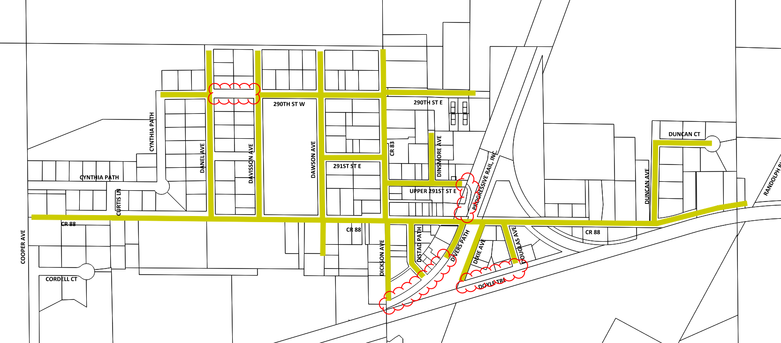
LOCAL STREET IMPROVEMENTS

Slide 13
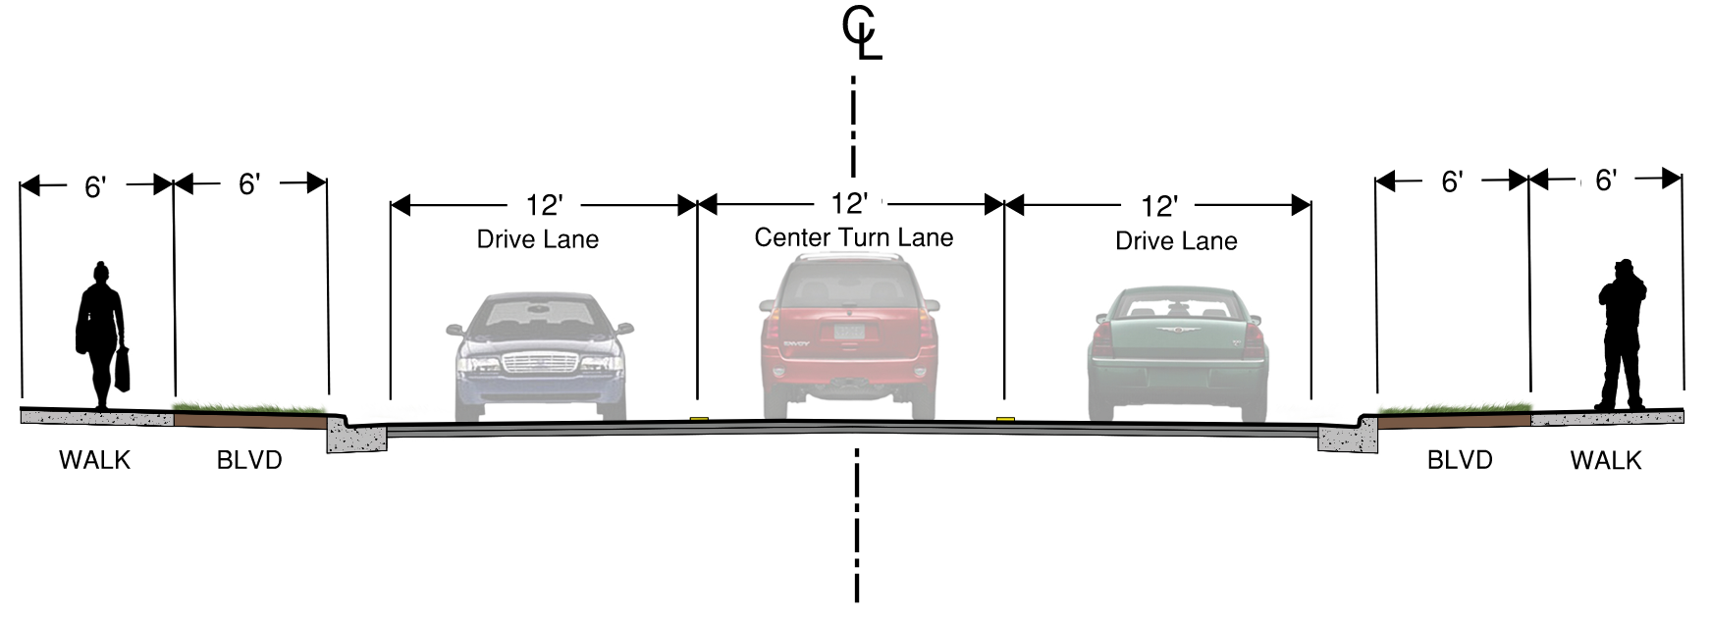
CSAH 88 STREET IMPROVEMENTS
4’
10’
10’
4’
PARKING LANE
DRIVE LANE
DRIVE LANE
PARKING LANE

Slide 14
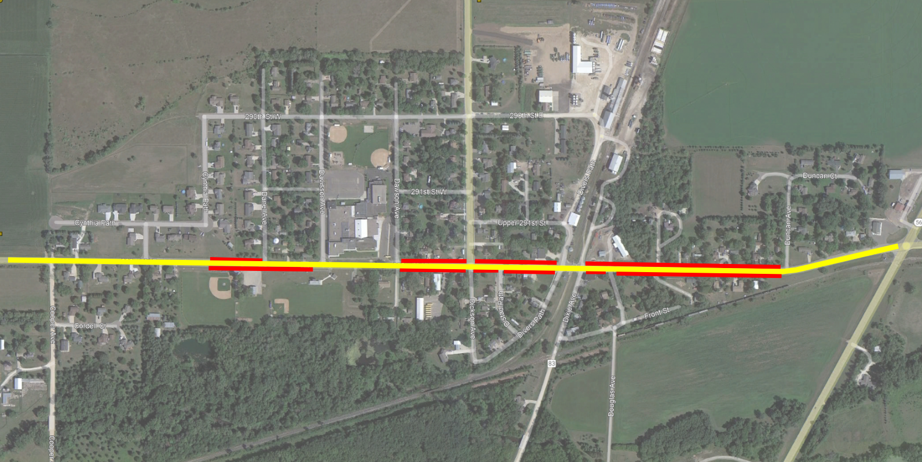
CSAH 88 STREET IMPROVEMENTS

Slide 15
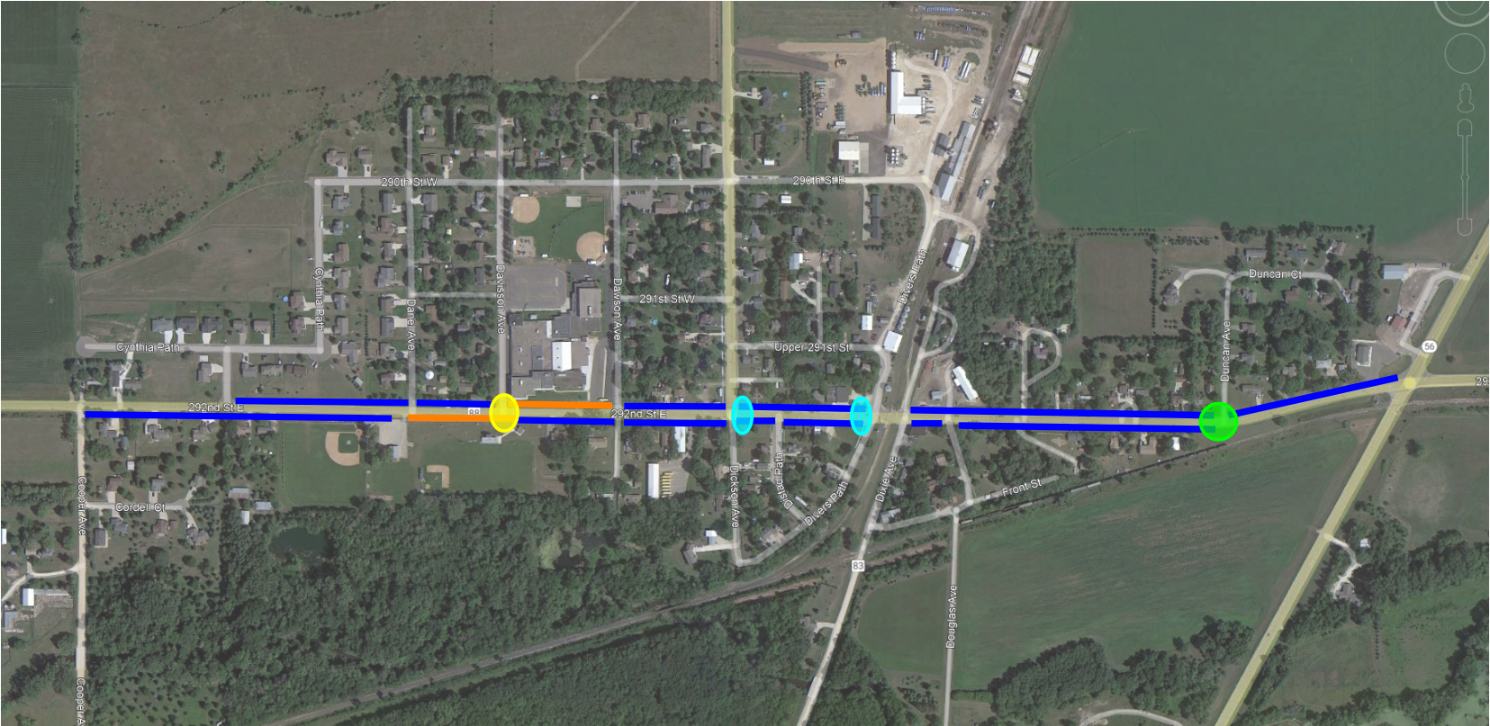
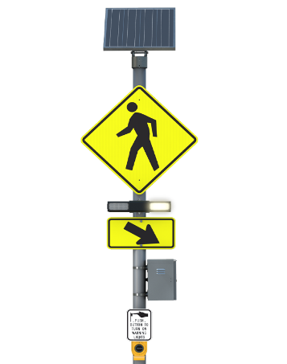
CSAH 88 PEDESTRIAN IMPROVEMENTS

Slide 16
Estimated Project Cost
 |  | CITY OF RANDOLPH | DAKOTA COUNTY
ESTIMATED CONSTRUCTION COST |  | $9,539,876 | $6,036,848
10% CONTINGENCY |  | $953,990 | $603,690
 |  | $17,134,404
PRELIMINARY DESIGN, FINAL DESIGN, GEOTECHNICAL |  | $746,794 | $298,145
LAND ACQUISITION (ESTIMATED) |  | $1,000,000
CONSTRUCTION ADMINISTRATION (ESTIMATED) |  | $650,000 | $151,480
TOTAL ESTIMATED PROJECT COST: |  | $12,890,660 | $6,640,538

Slide 17
Requested Action
Approve the plans and project specifications and authorize advertisement for bids

Slide 18
Thank You! Questions?
Matt Blazer, P.E.
Consultant City Engineer
612-756-4823
Matt.blazer@bolton-menk.com

